Slide 1
SPATIO-TEMPORAL VARIABILITY OF LIGHTNING ACTIVITY AND CHARACTERISTICS OF WILDFIRES IN DIFFERENT NATURAL ZONES OF WESTERN SIBERIA OVER THE PERIOD OF 2016-2021
Kharyutkina Elena, Moraru E.I., Pustovalov K.N.
Institute of Monitoring of Climatic and Ecological Systems SB RAS, Tomsk
e-mail: kh_ev@mail2000.ru

Slide 2
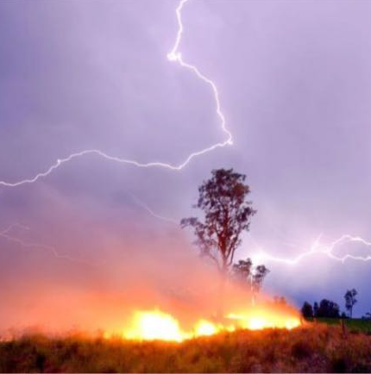
Fires Lightning-ignited wildfires (LIWs)
LIWs account for
28% of all fires in Siberia (Gorbatenko V.P., 2020)
up to 37% in the Tomsk region (Baranovskiy N.V., 2017)
Thunderstorm activity and its role in fire occurrence has been the subject of a significant amount of research in different regions of the world:
in boreal forests and permafrost zones (Chen Y., 2021; Larjavaara M., 2005; Vasiliev, M.S., 2021; Peterson, D., 2010)
in mountain regions (Moris, J.V., 2020)
in tropical and subtropical ecosystems (Podschwit, H., 2020; Pérez-Invernón, F.J.,2021; Menezes, L.S., 2022).

Slide 3
Goal:
the analysis of spatial and temporal variability of the distribution of fires and lightning activity for different natural zones of Western Siberia for March-October
during 2016-2021

Slide 4
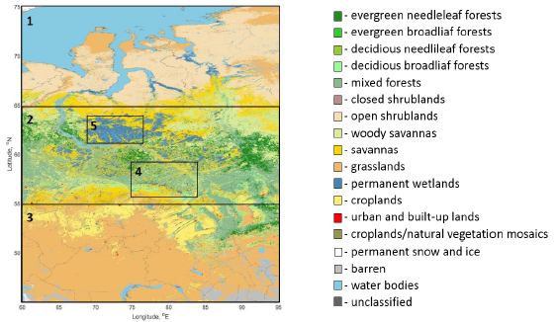
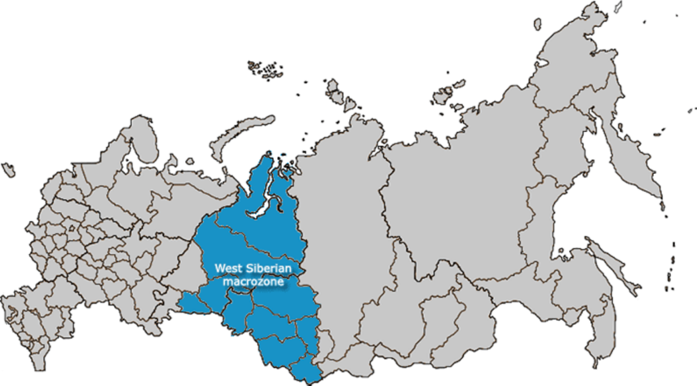
Materials and Methods
Characteristics:
Lightning discharges
Hotspots
Datasets (March-October for 2016-2021):
World Wide Lightning Location Network data (WWLLN)
Fire Information for Resource Management System (FIRMS)
spatial resolution is 1x1 km², temporal resolution is 1 day
MODIS Land Cover Type Product (MCD12Q1)
500-m spatial resolution
Vegetation and selected natural zones July 15, 2016
Area 1 (65–75° N, 60–95° E) - the northern part,
dominated by shrubs and grasslands
Area 2 (55–65° N, 60–95° E)- the central part,
occupied to a greater extent by the mixed forest and savannah zones
Area 3 (45–55° N, 60–95° E) - the southern part
(including the northeastern Kazakhstan), dominated by grasslands, with cropland, savannah (in the western part) and mixed forest (in the eastern part) only near 53–55° N
Area 4 (56–59° N, 75–84° E) - the Great Vasyugan Mire
Area 5 (61–64° N, 69–77° E) - permanent wetlands
Western Siberia: 45-75° N, 60 -95° E

Slide 5
Materials and Methods
Probability
of a fire caused by each lightning event
Δt = 1-10 days
0.25°
Dmax = 10 km
lightning
0.25°
hotspot
hotspot
lightning
$$B=1−\prod_{i=1}^{n}{\left(1−A_{i}\right)}$$
P (i, j) = (nl/n) * 100%
nl - the number of fires likely caused by lightning in one cell in one day,
n – the total number of fires in the same cell in the same day
$$A=\left(1−\frac{∆t}{∆t_{max}}\right)×\left(1−\frac{D}{D_{max}}\right)$$
Proximity index

Slide 6
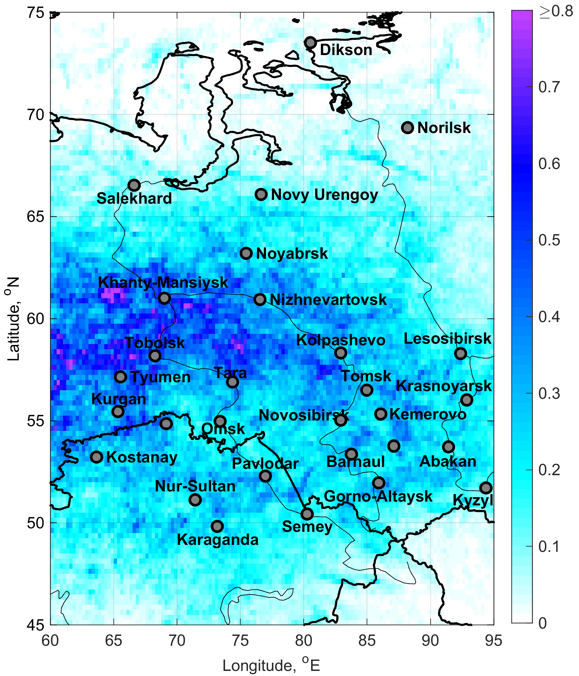
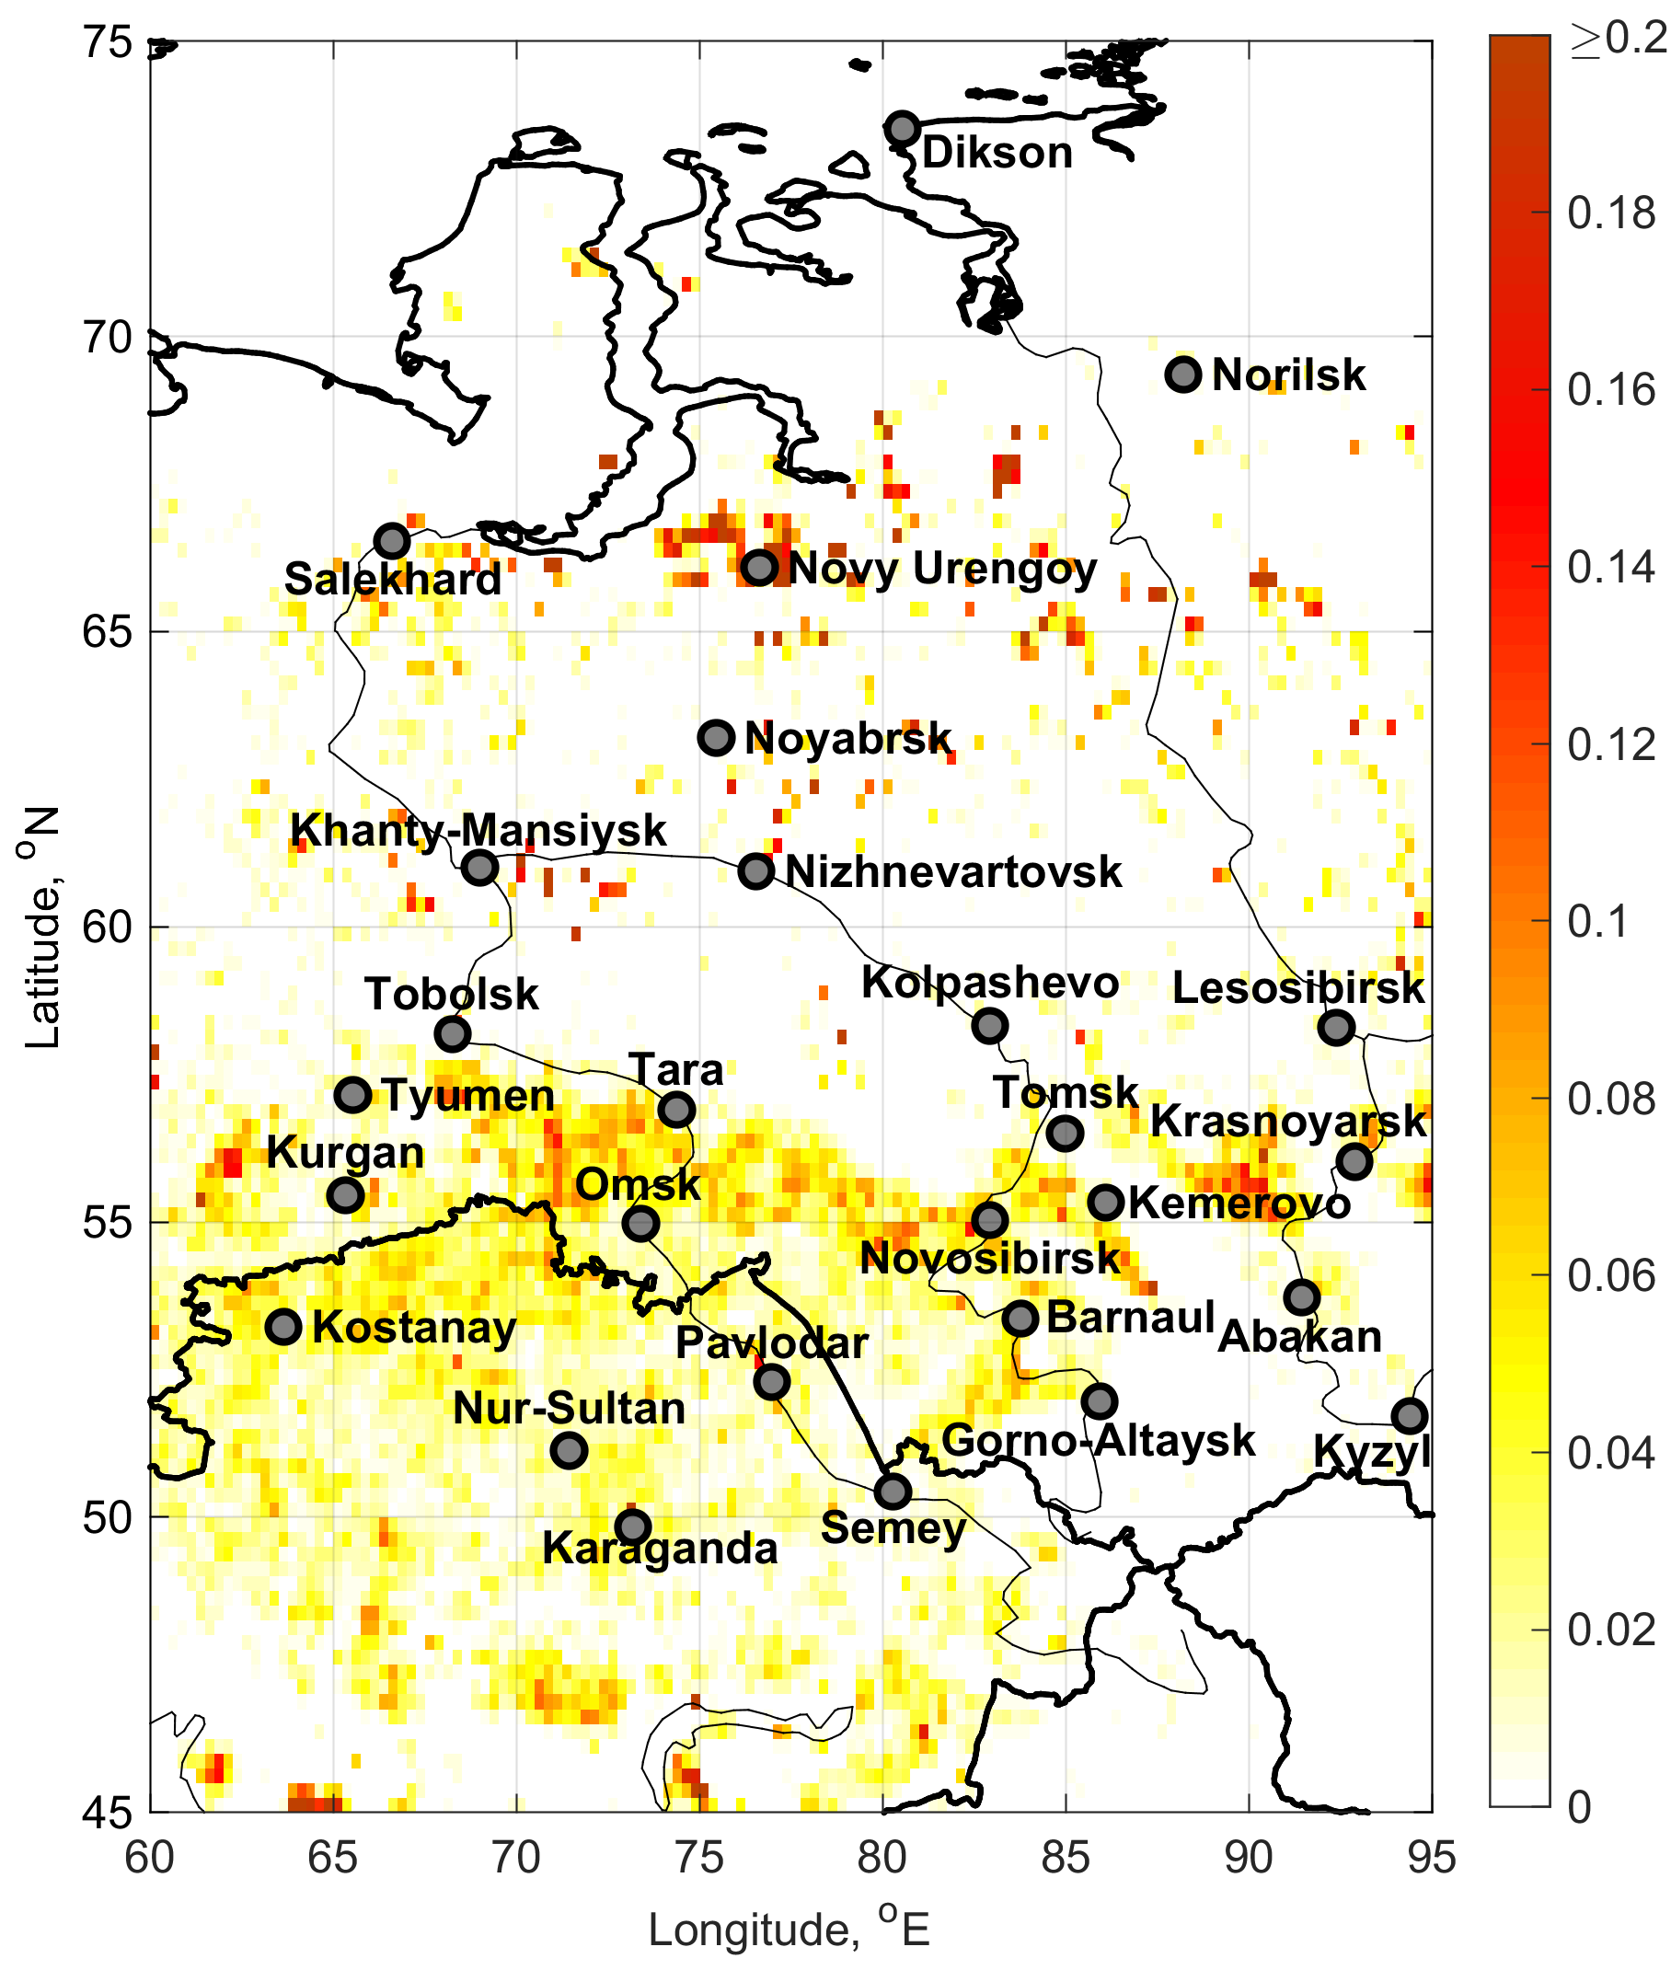
Spatial variability
lightning discharge density
hotspots density
flashes per km² per year
hotspots number per km² per year
warm season
2016 - 2021

Slide 7
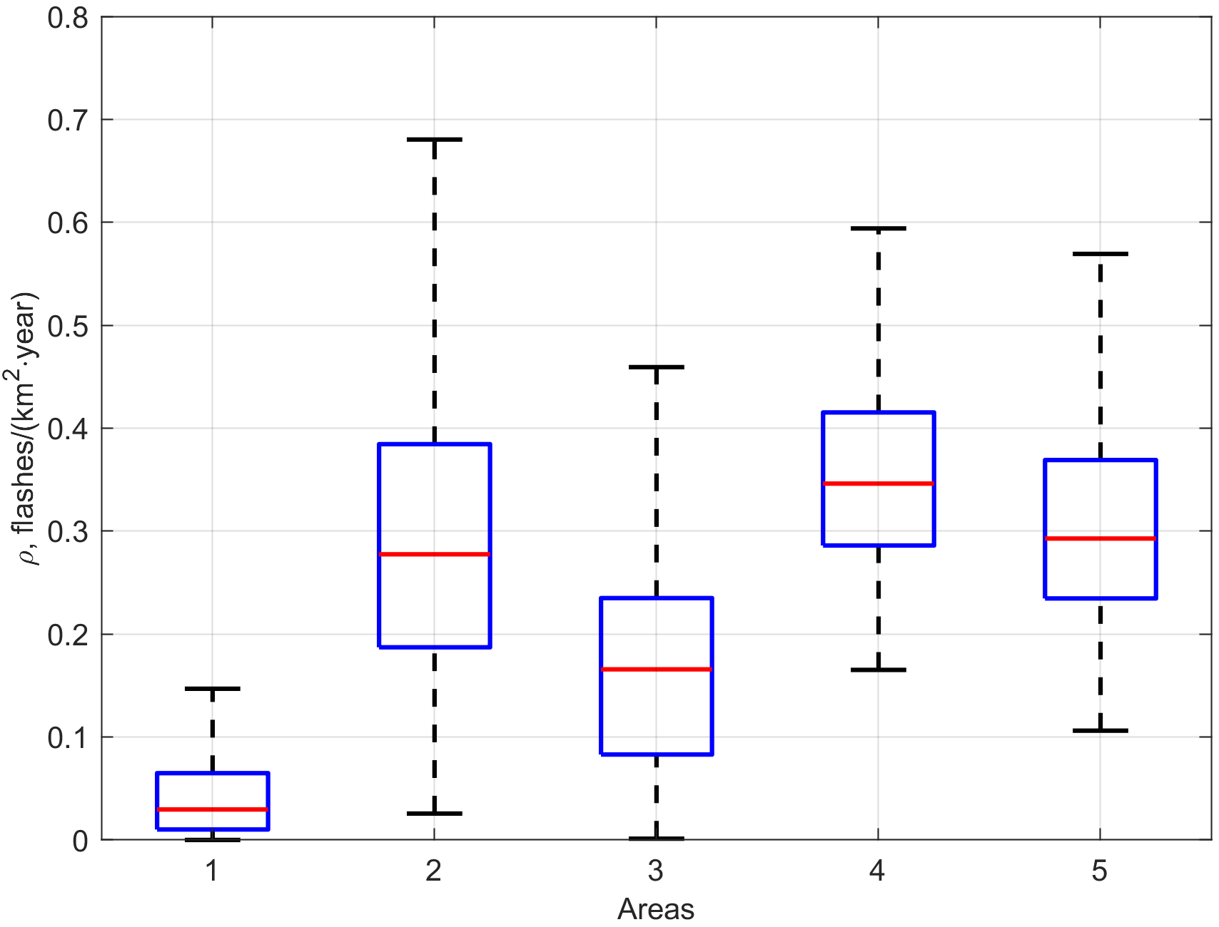
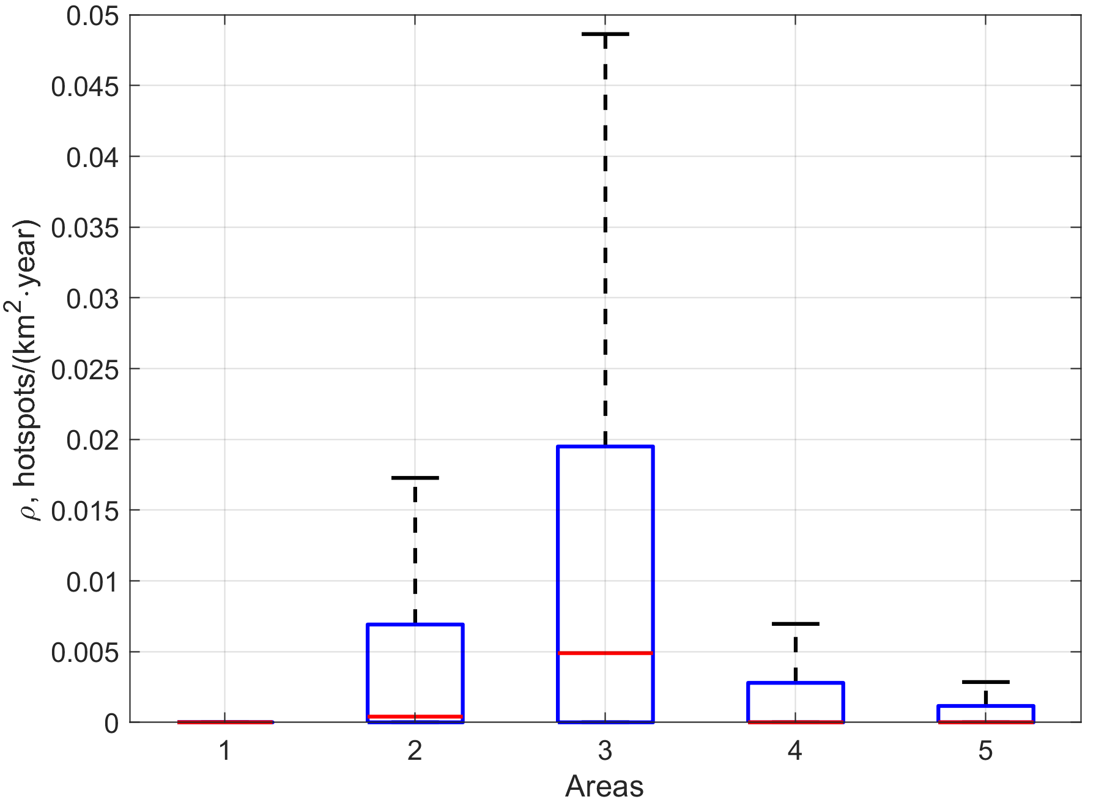
Statistical characteristics
lightning discharge density
hotspots density
flashes per km² per year
hotspots number per km² per year
warm season
2016 - 2021

Slide 8
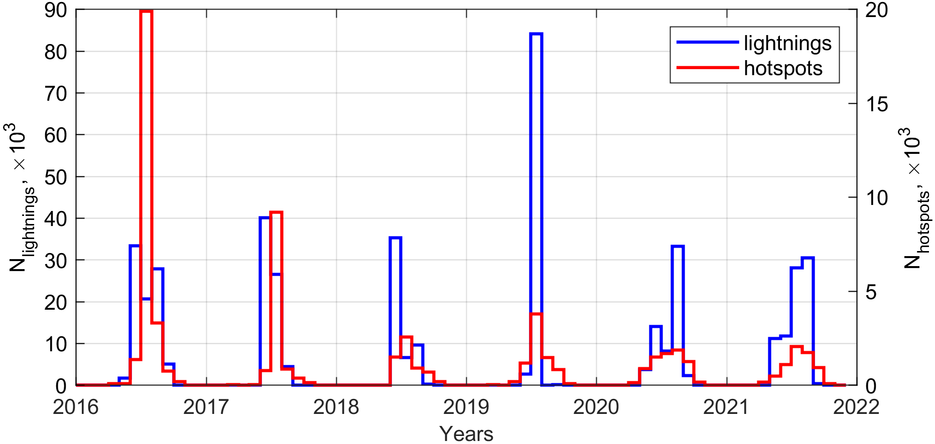
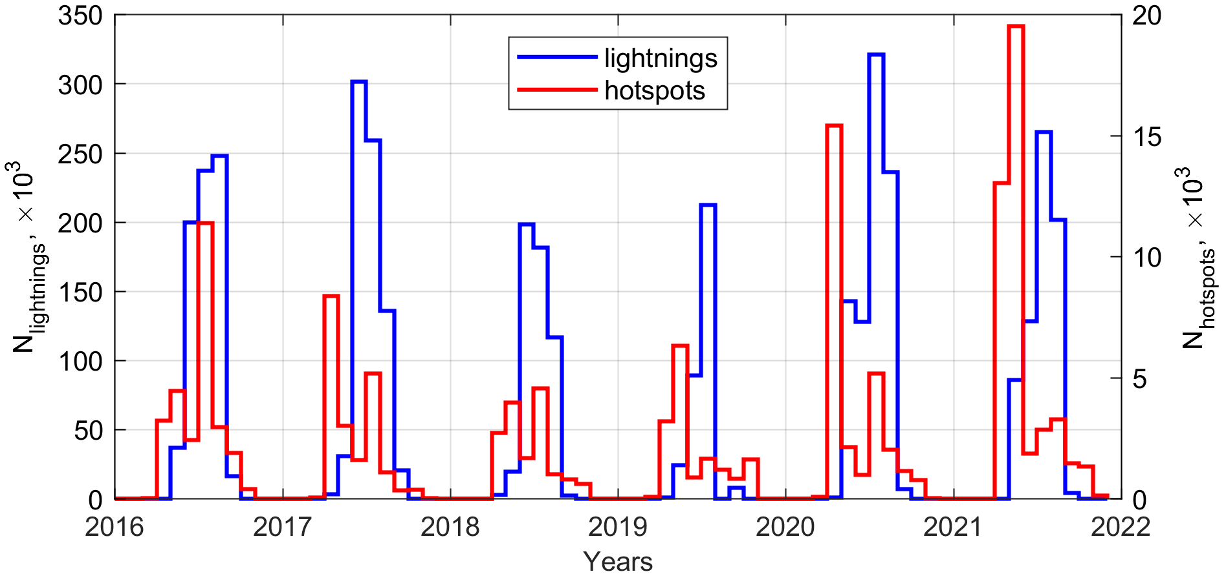
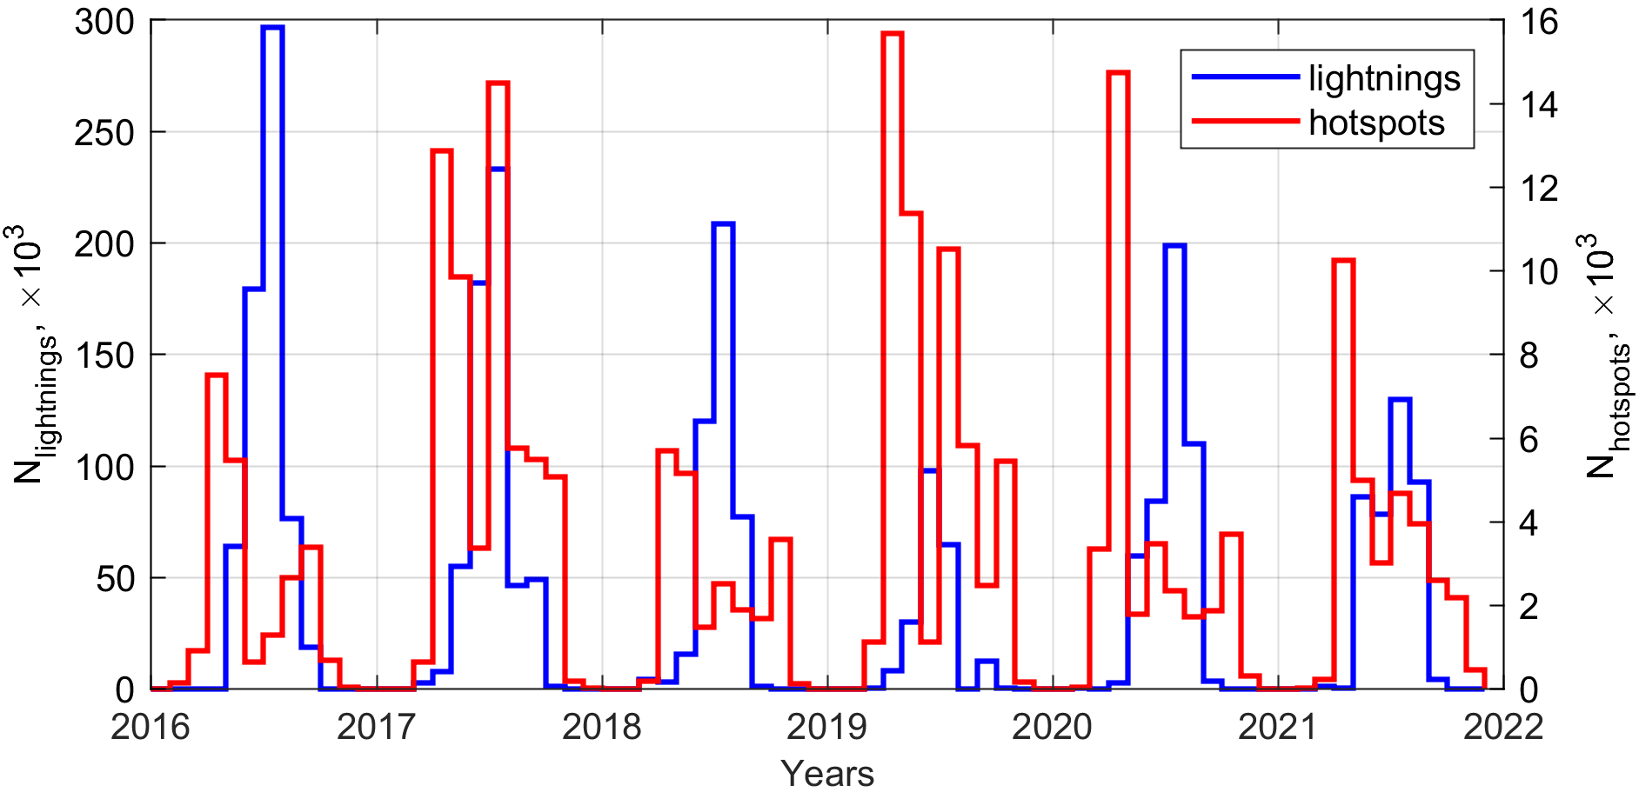
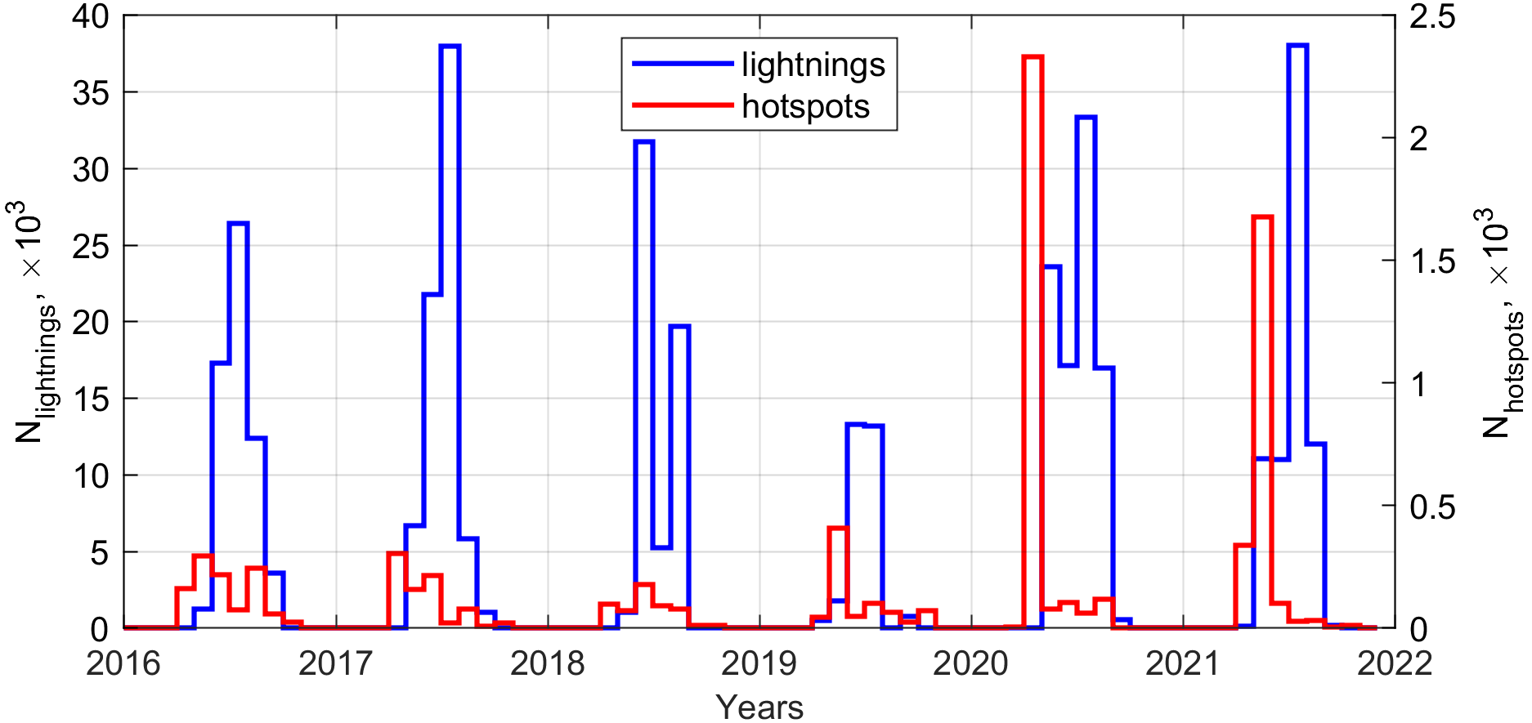
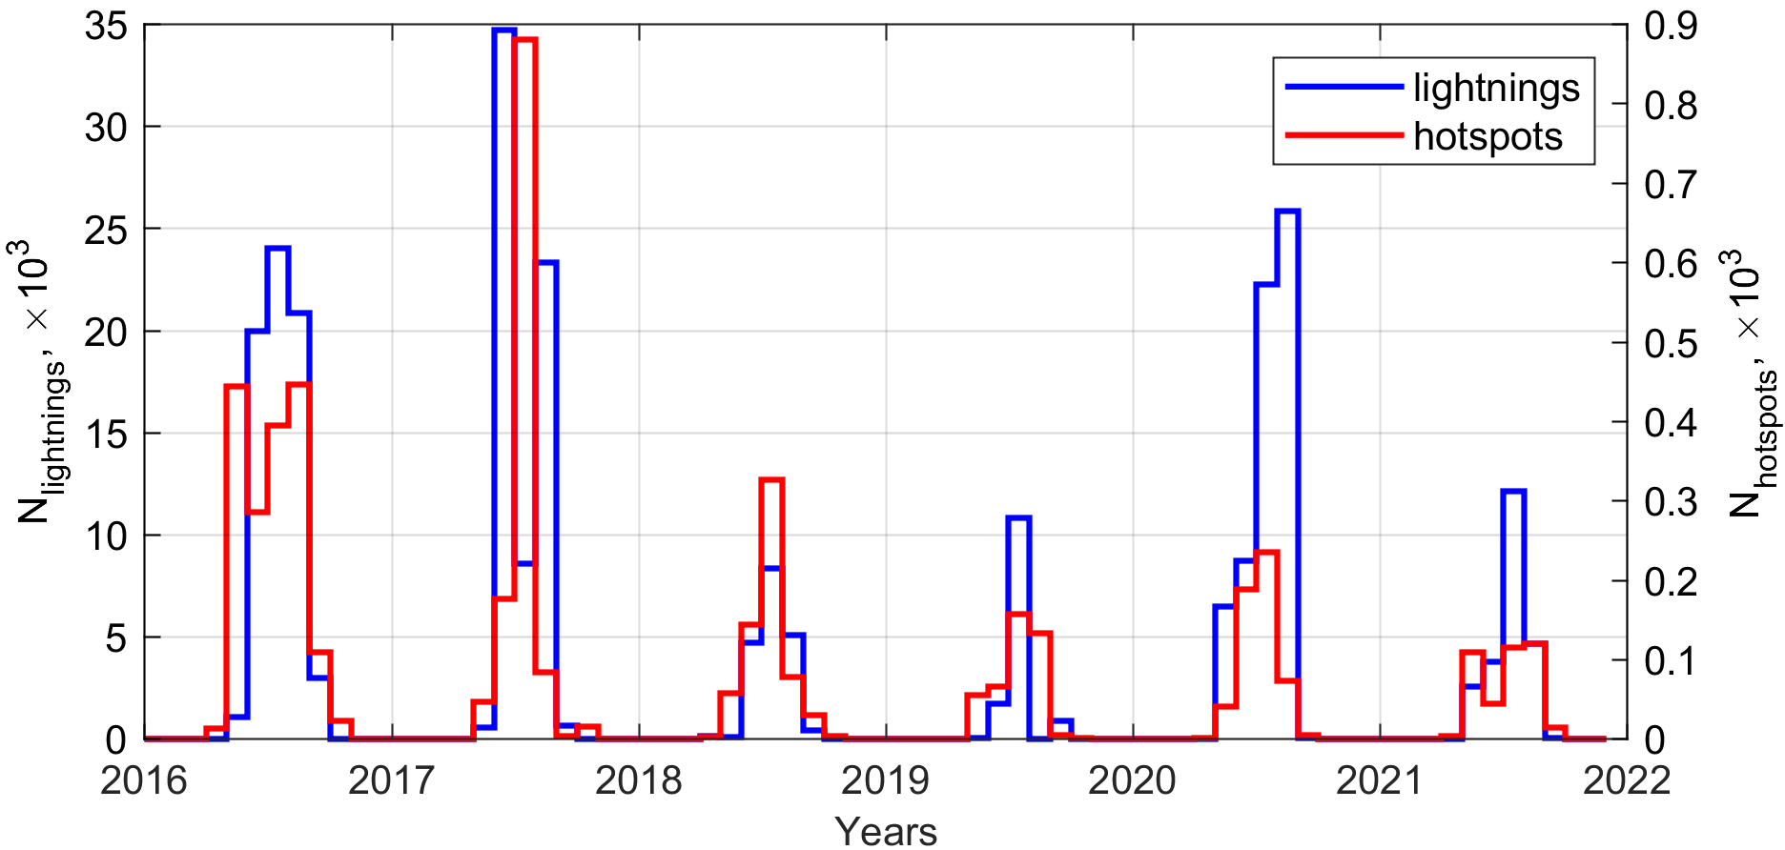
Interannual variability
North of Western Siberia (Area 1)
Center of Western Siberia (Area 2)
South of Western Siberia (Area 3)
The Great Vasyugan Mire (Area 4)
Permanent wetlands (Area 5)
2016 - 2021

Slide 9
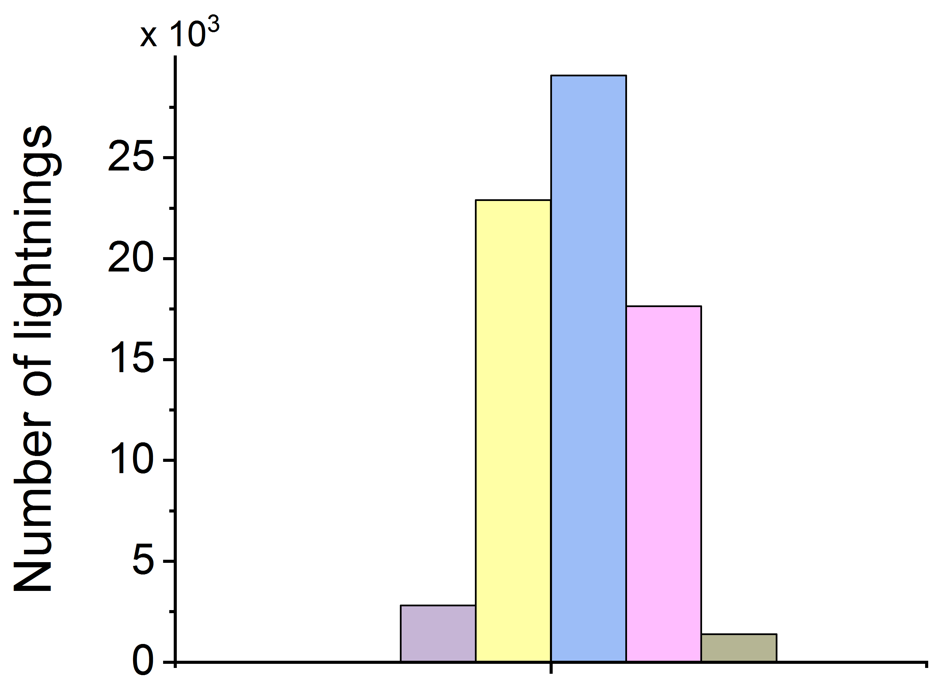
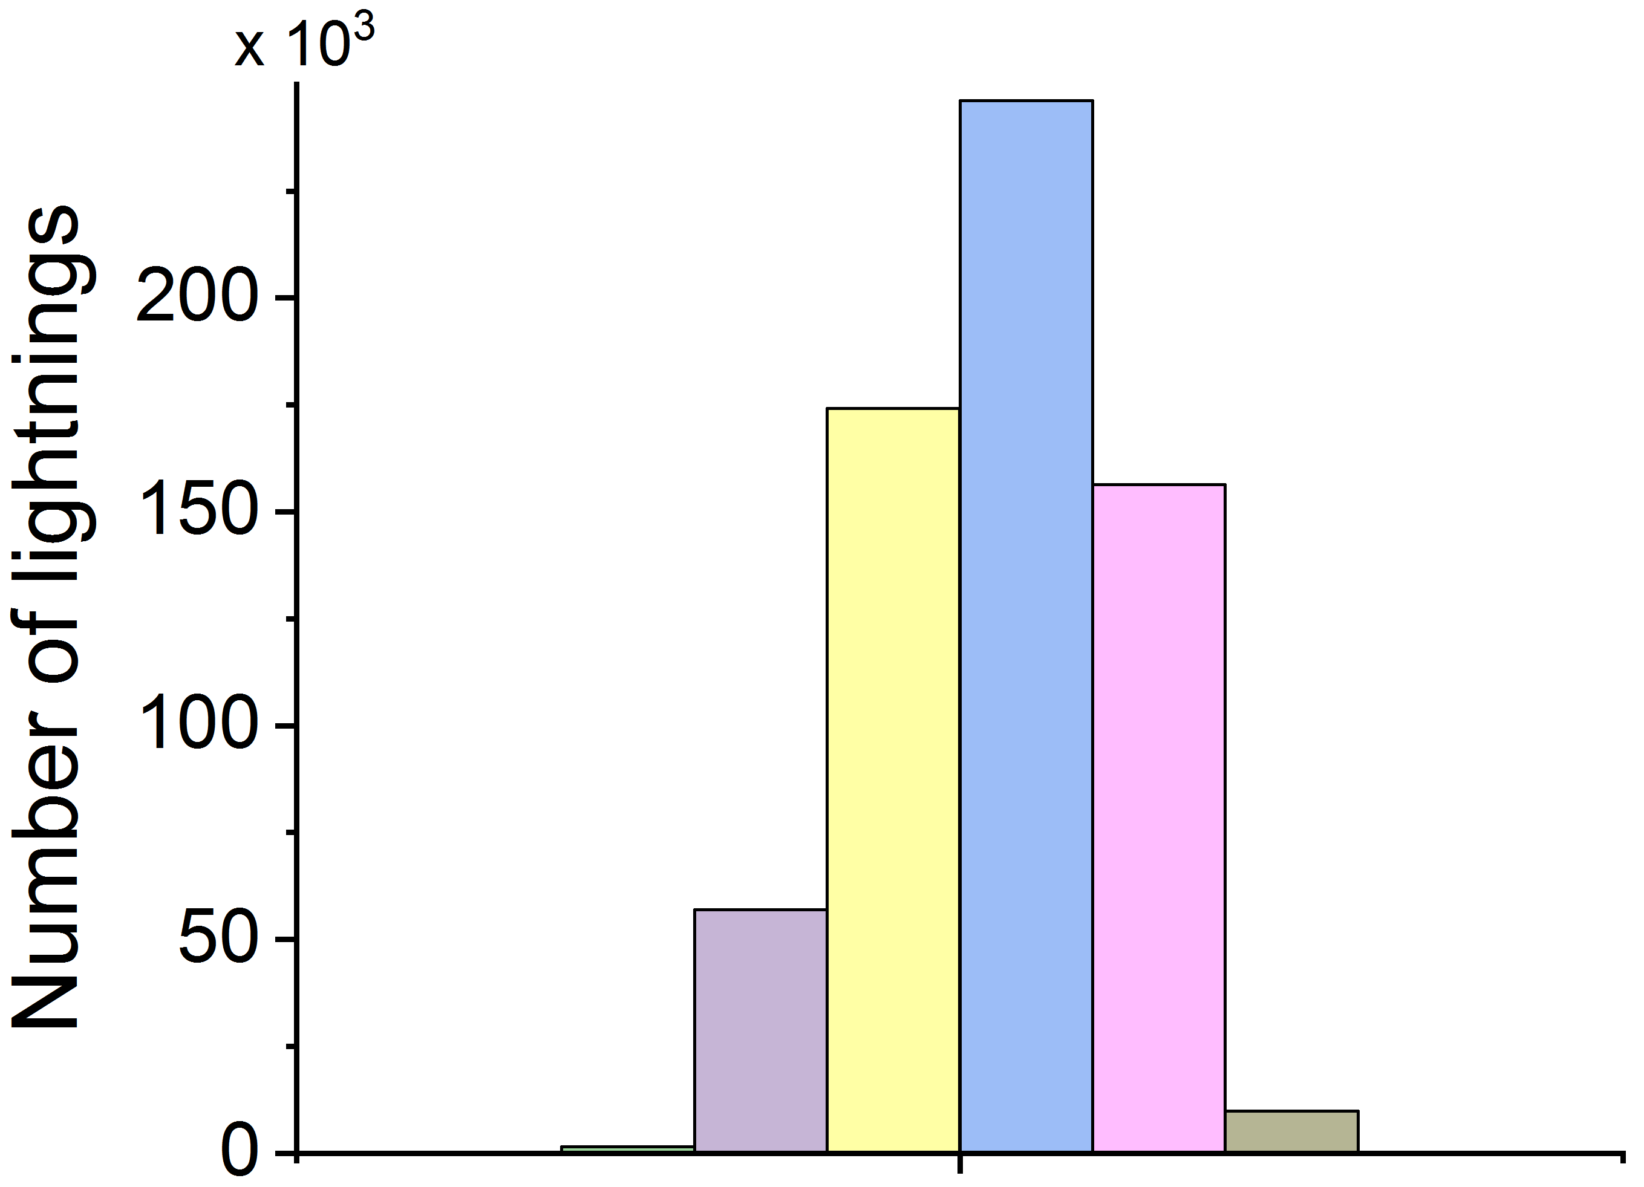
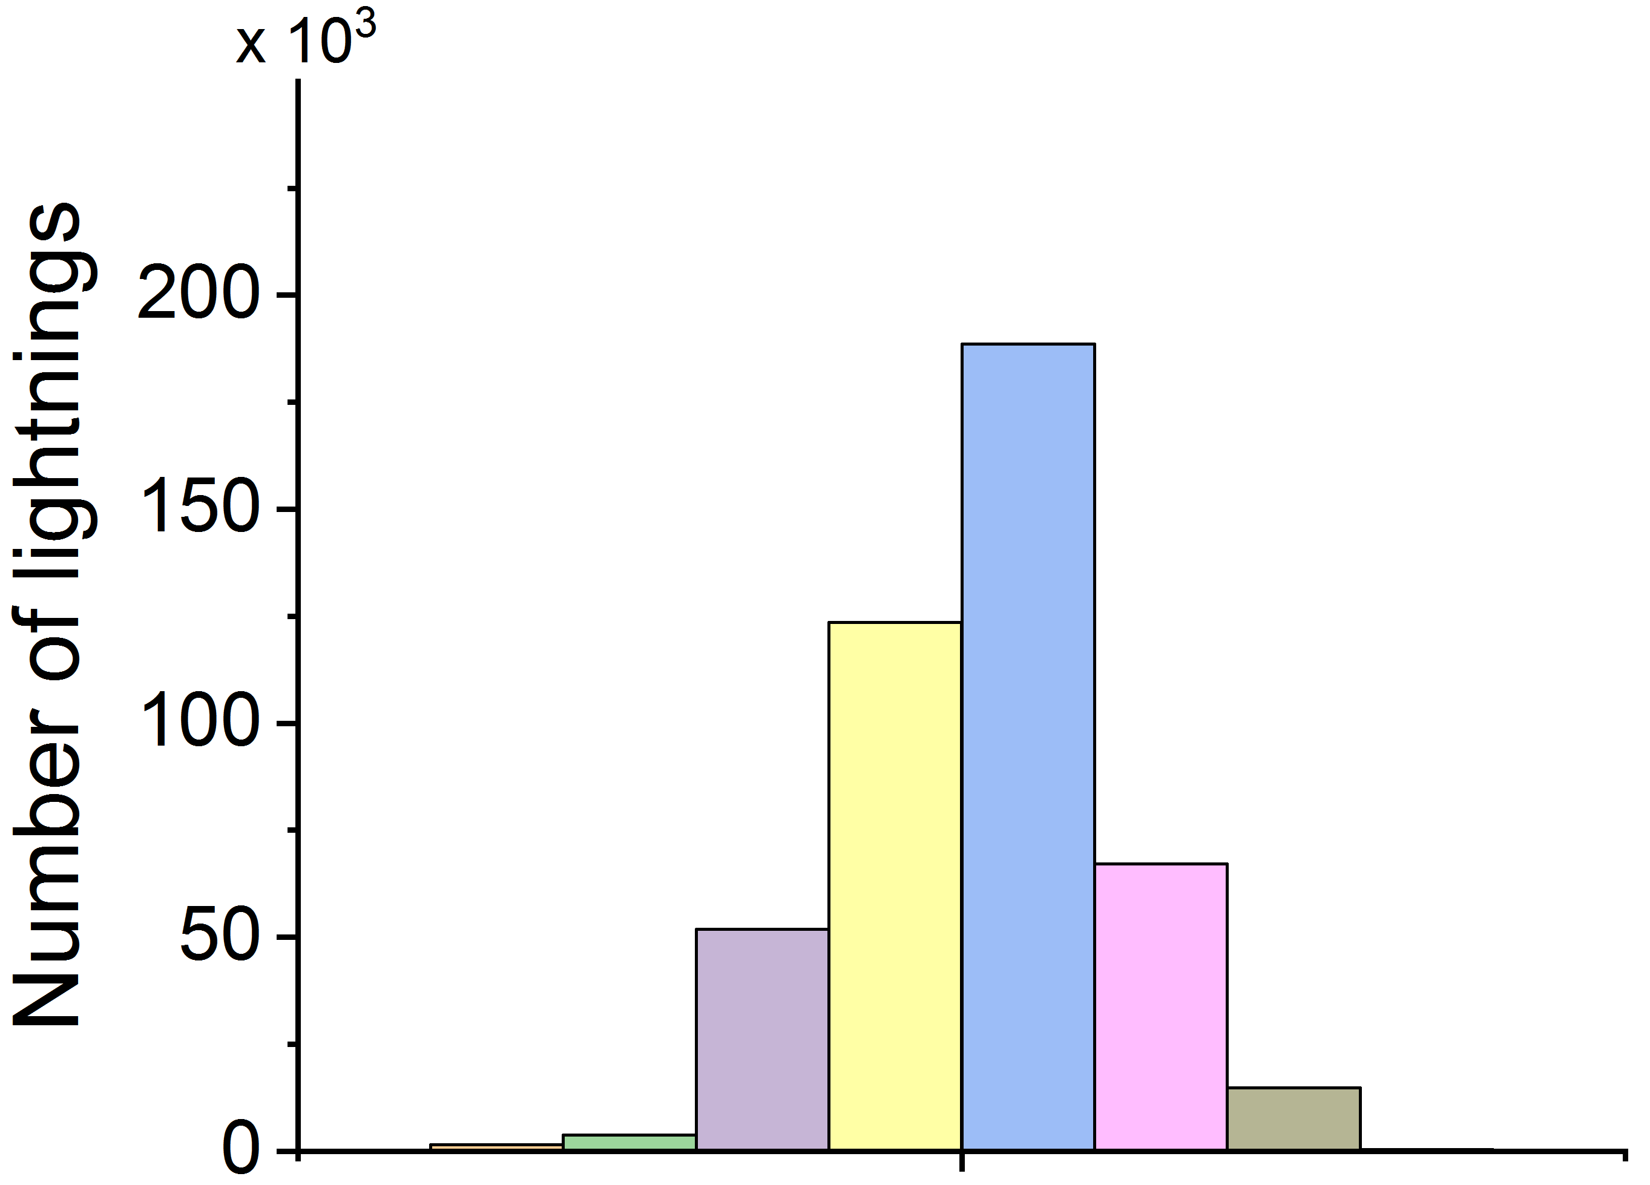
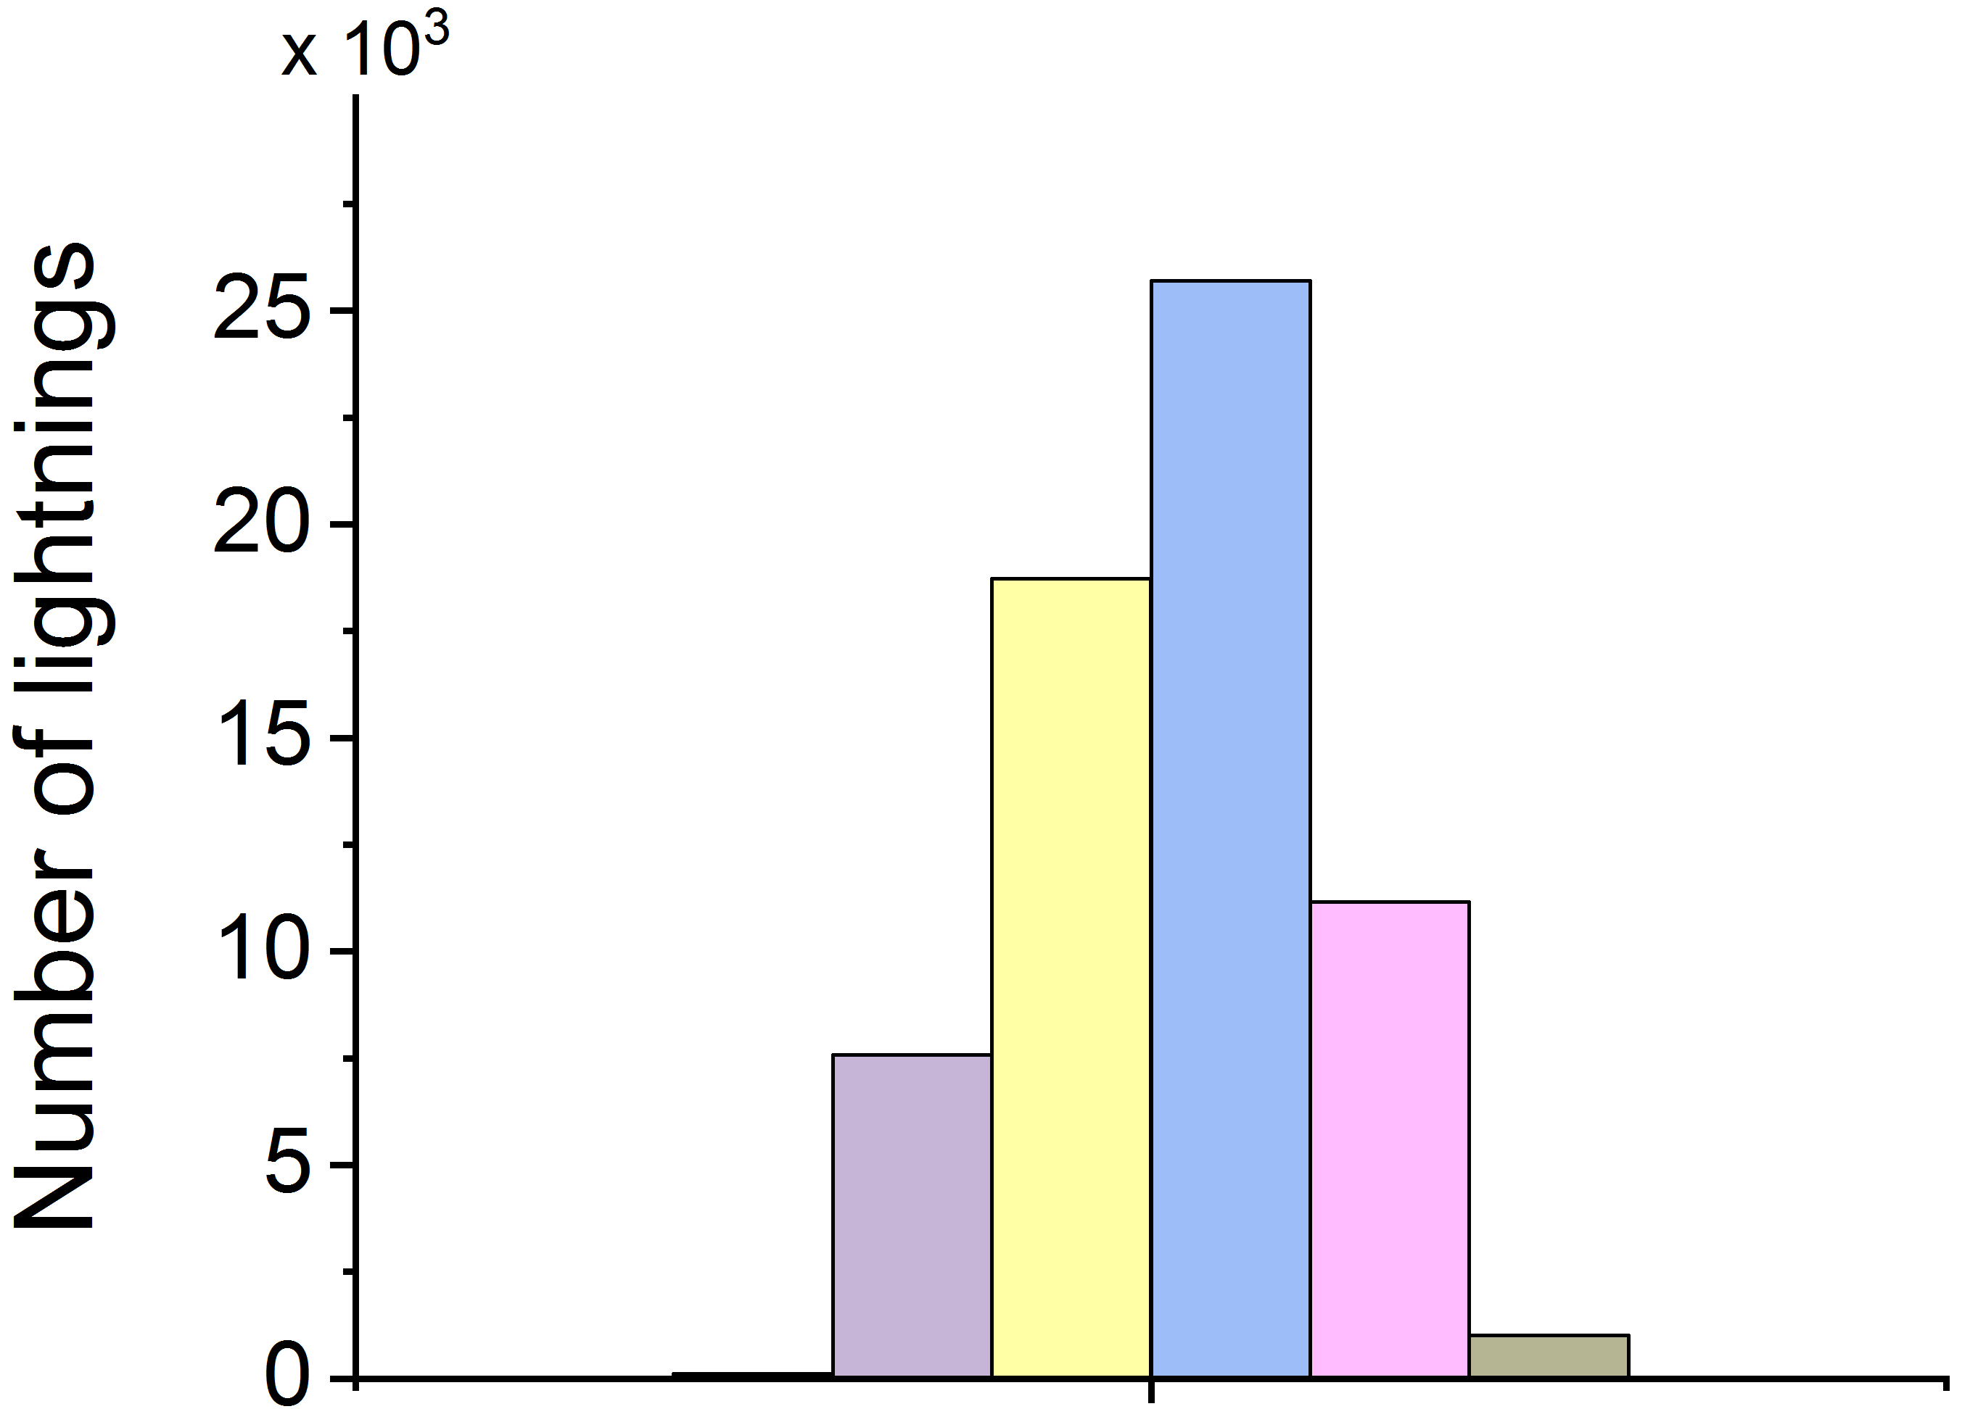
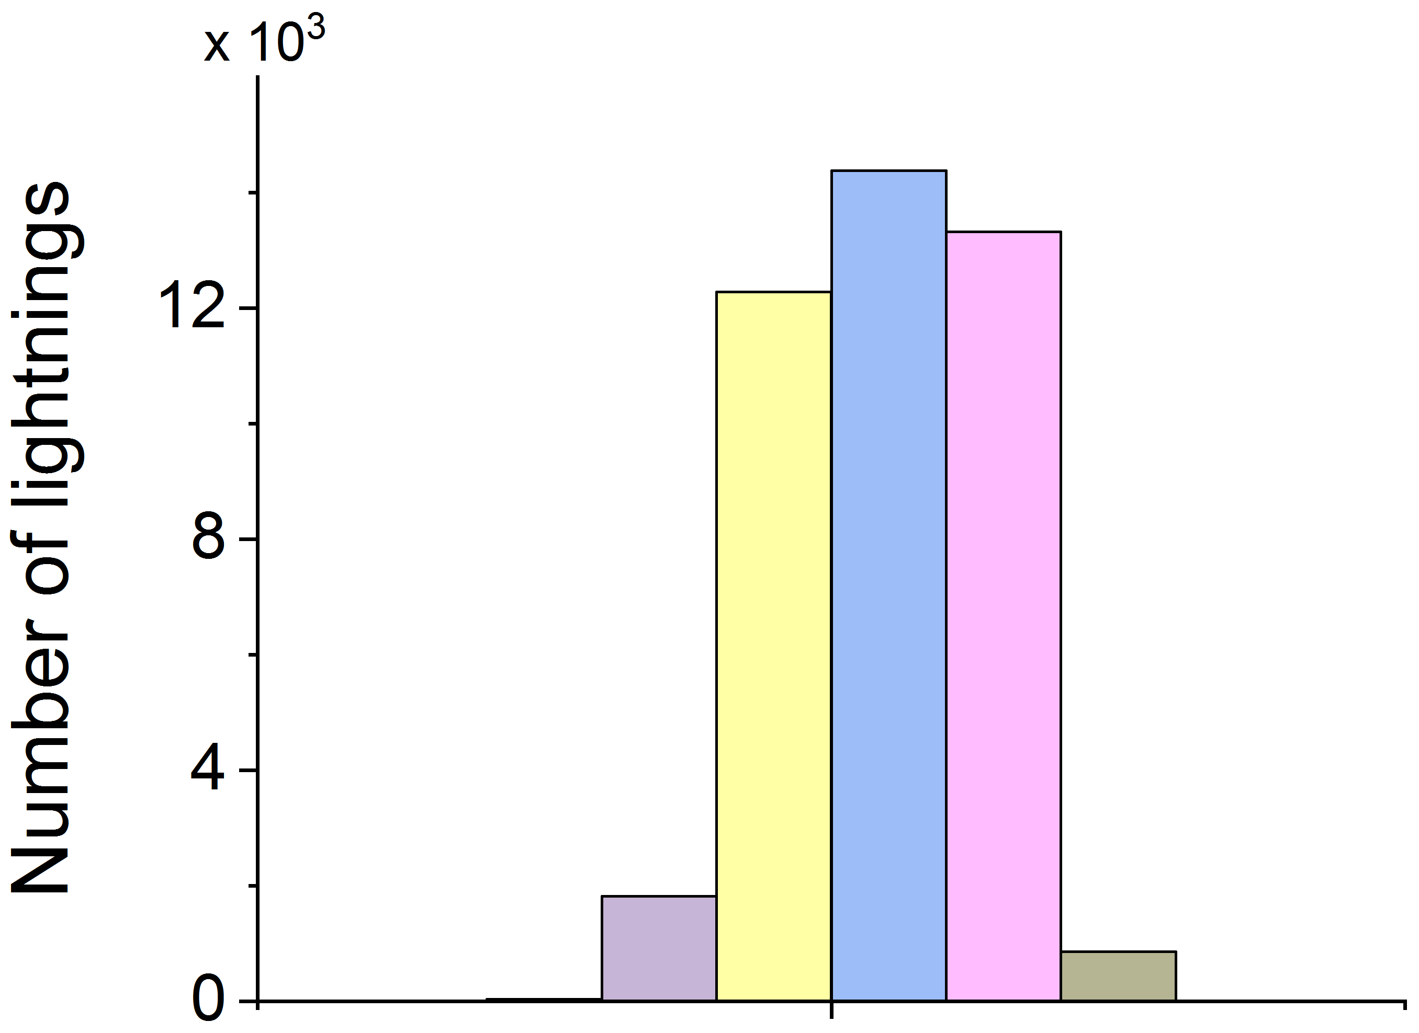
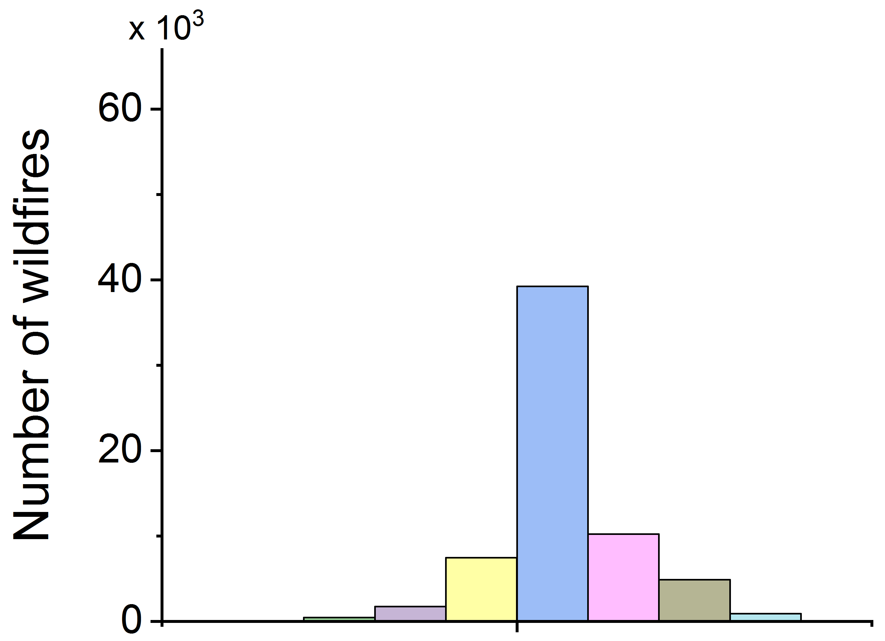
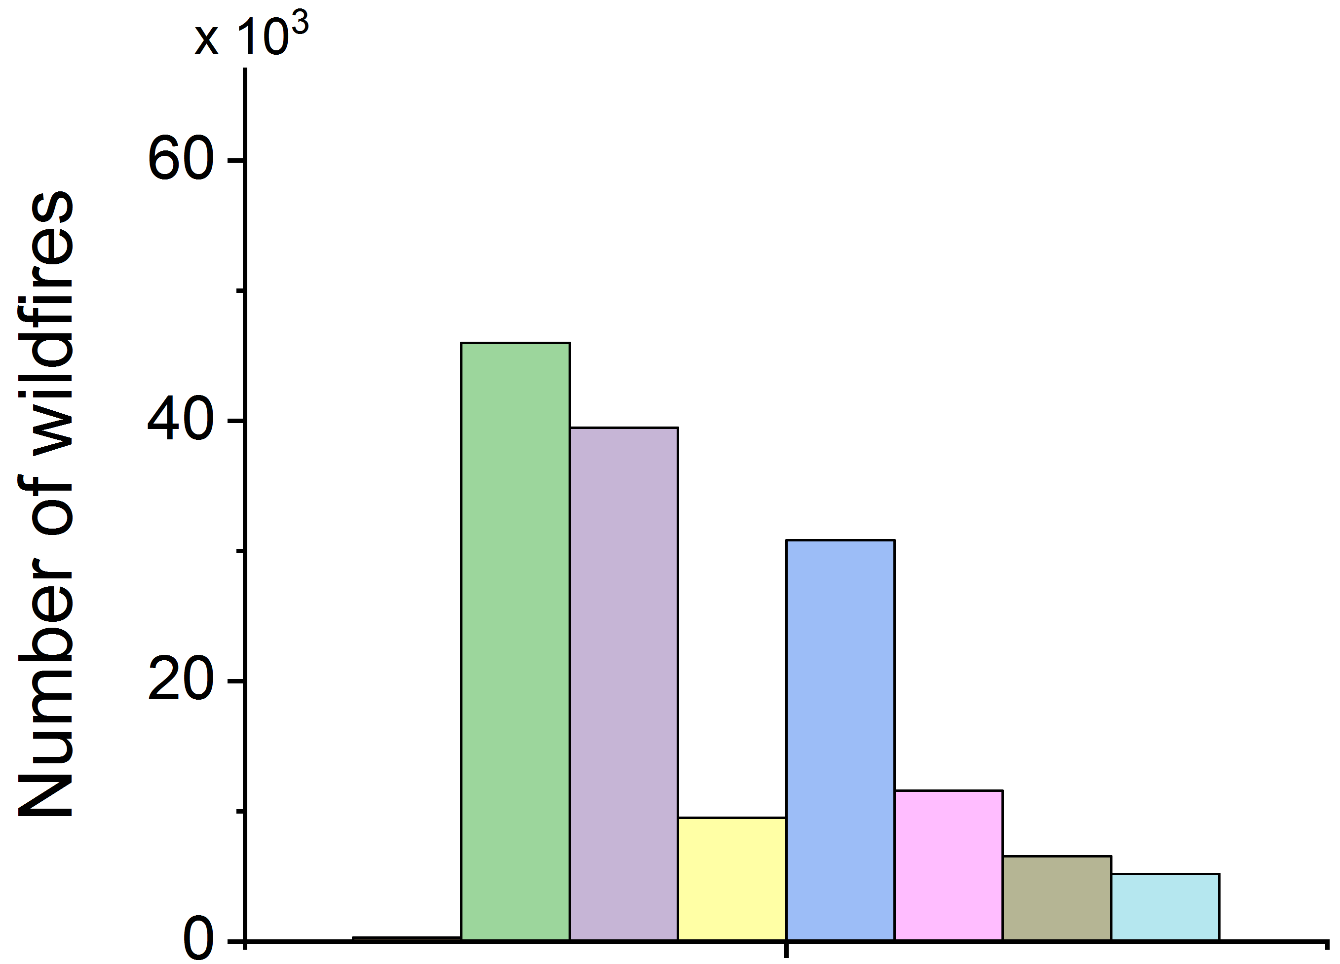
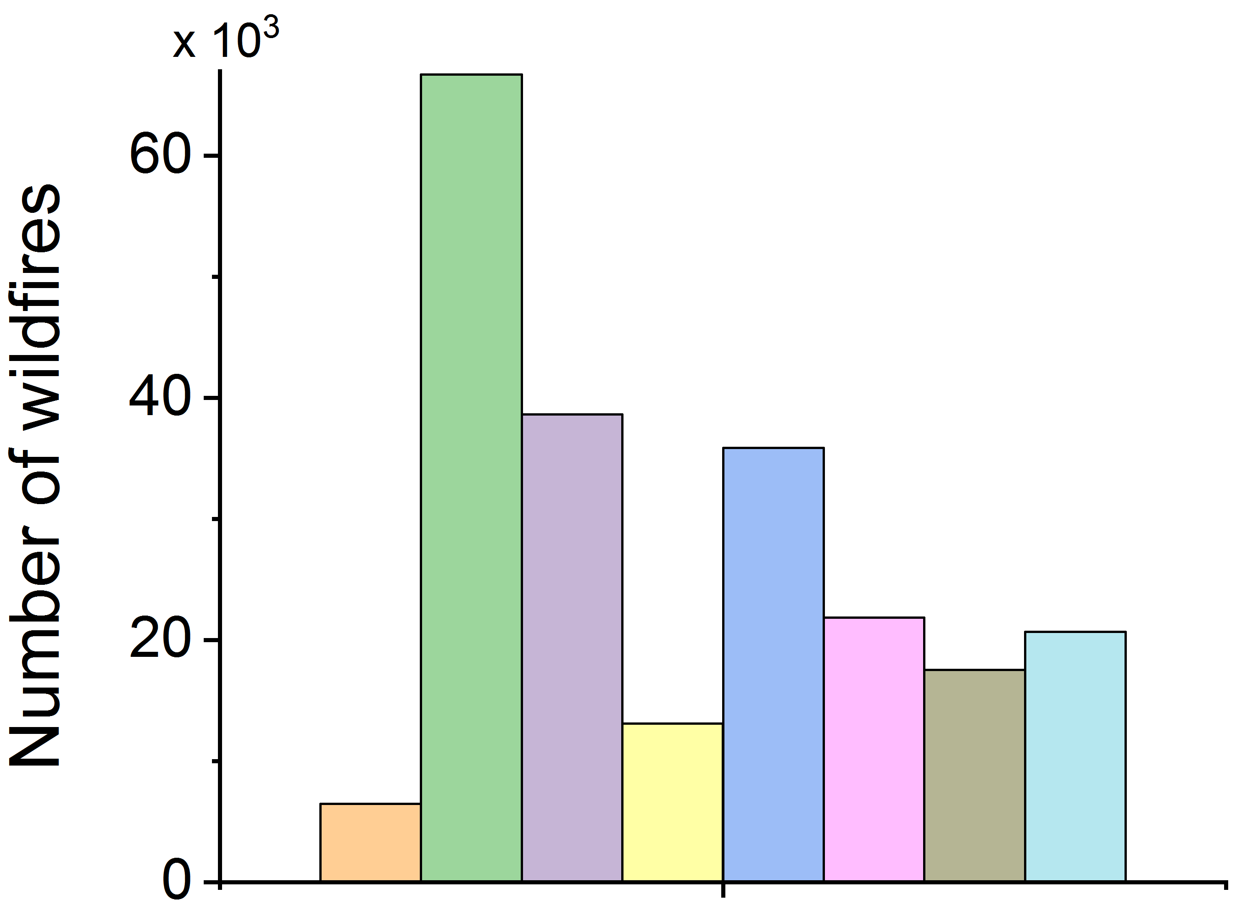
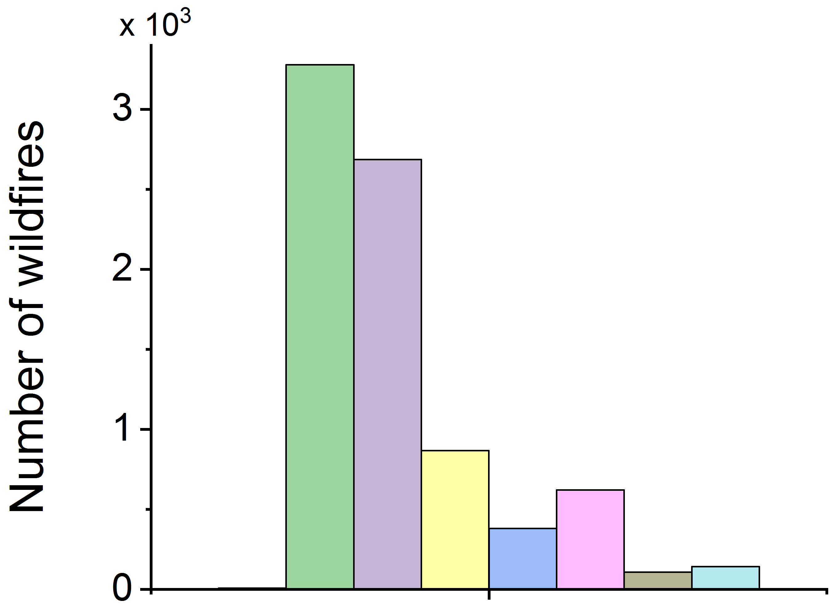
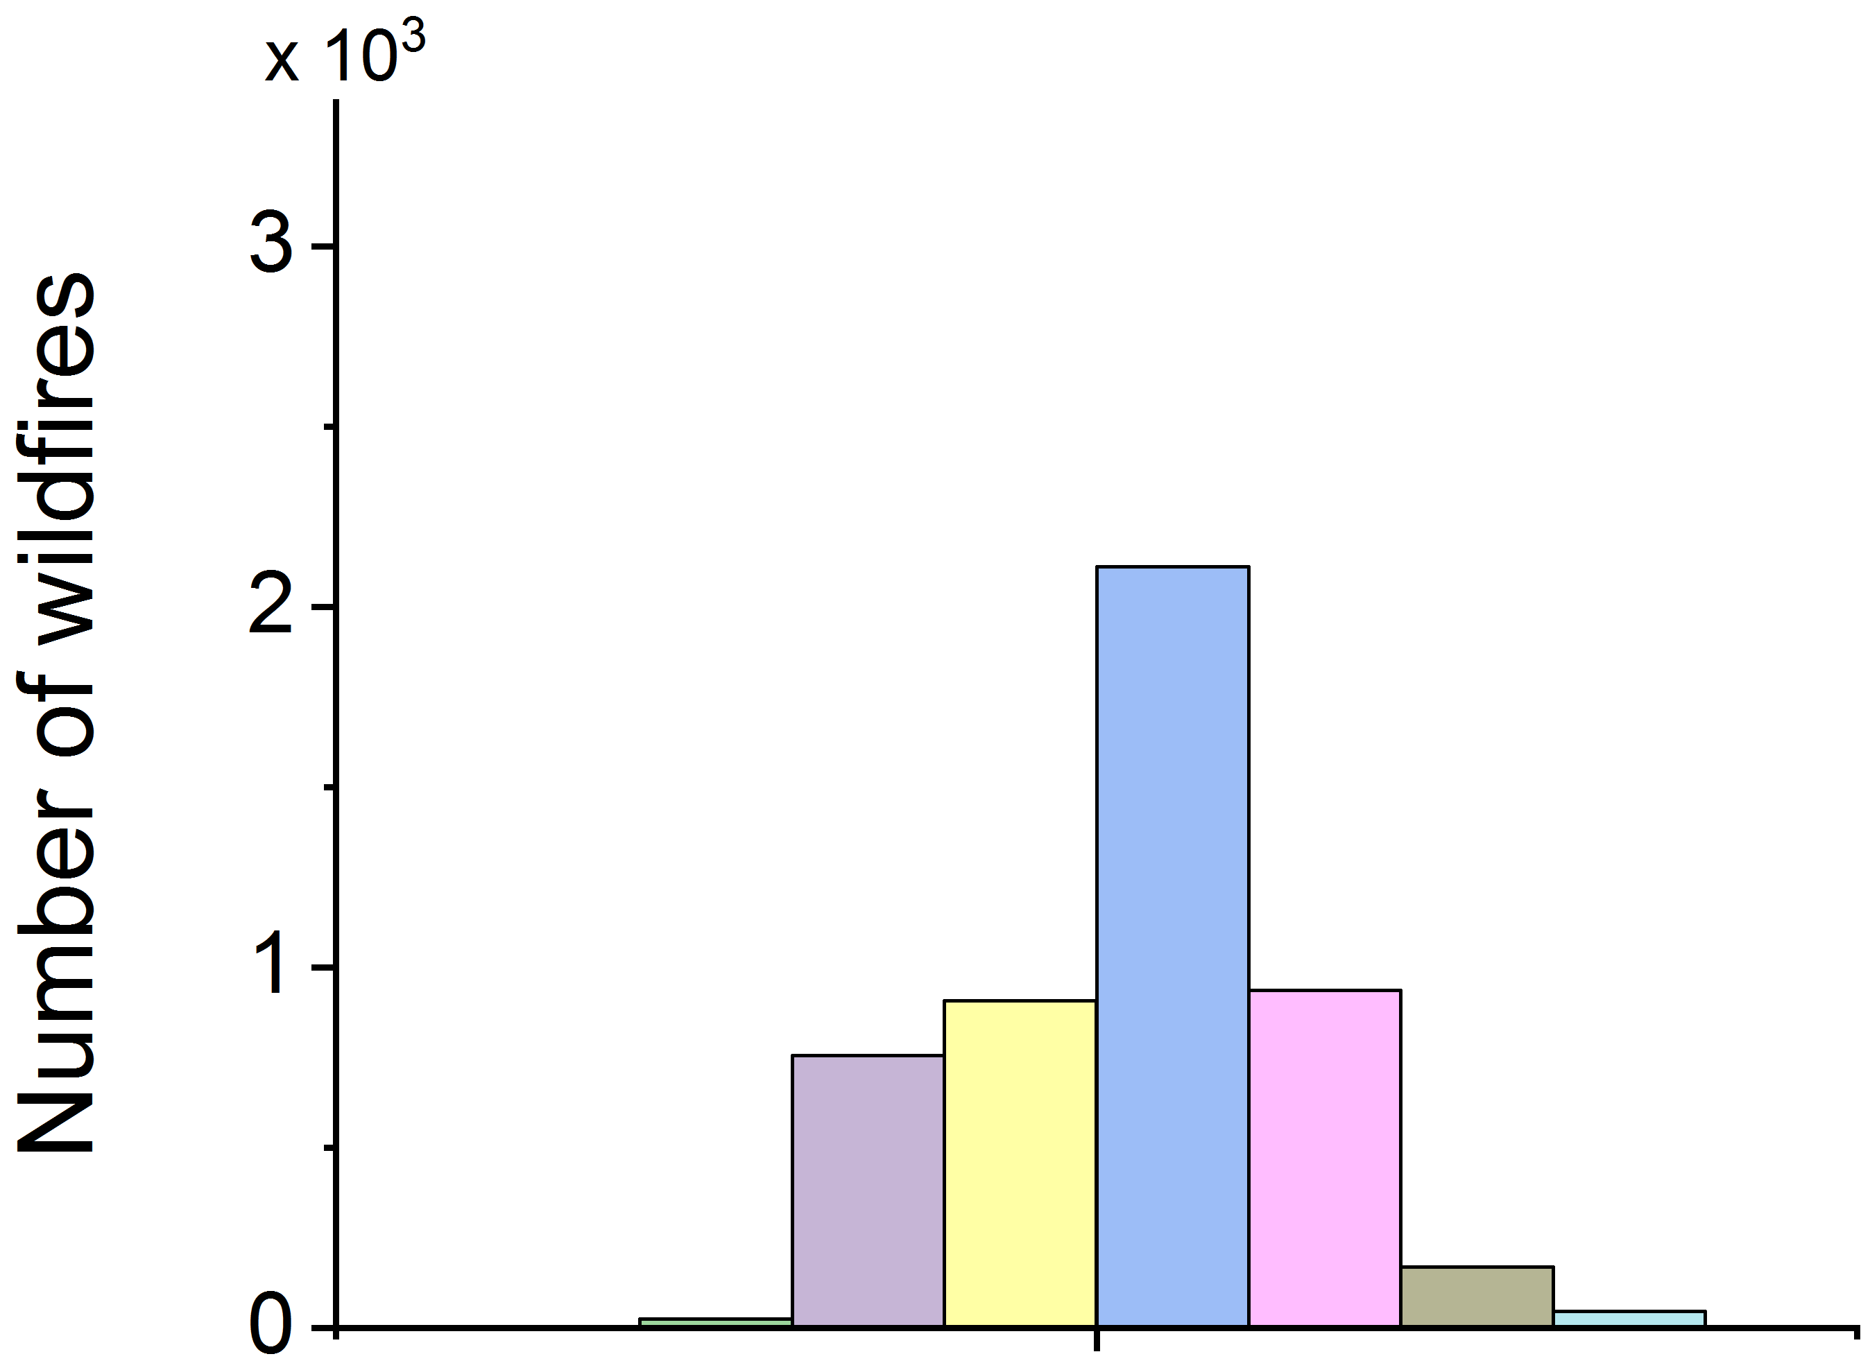
Seasonal variability Western Siberia
North (Area 1)
Center (Area 2)
South (Area 3)
The Great Vasyugan
Mire (Area 4)
Permanent
wetlands (Area 5)
Lightning
North (Area 1)
Center (Area 2)
South (Area 3)
The Great Vasyugan
Mire (Area 4)
Permanent
wetlands (Area 5)
Hotspots
2016-2021

Slide 10
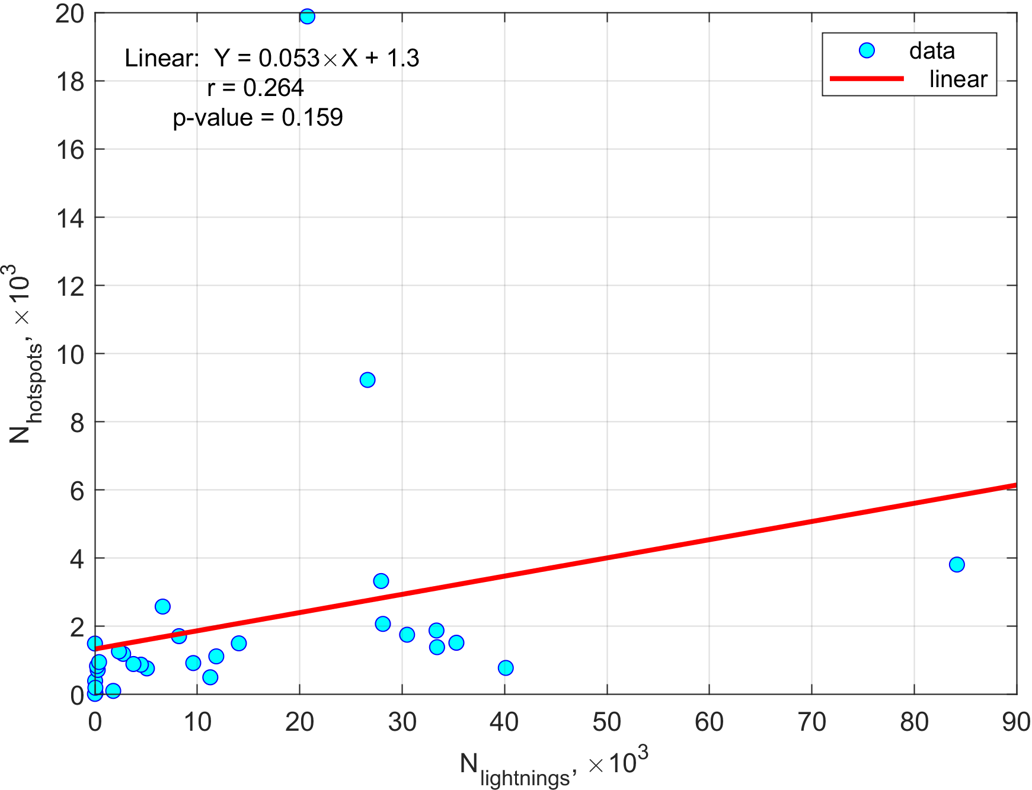
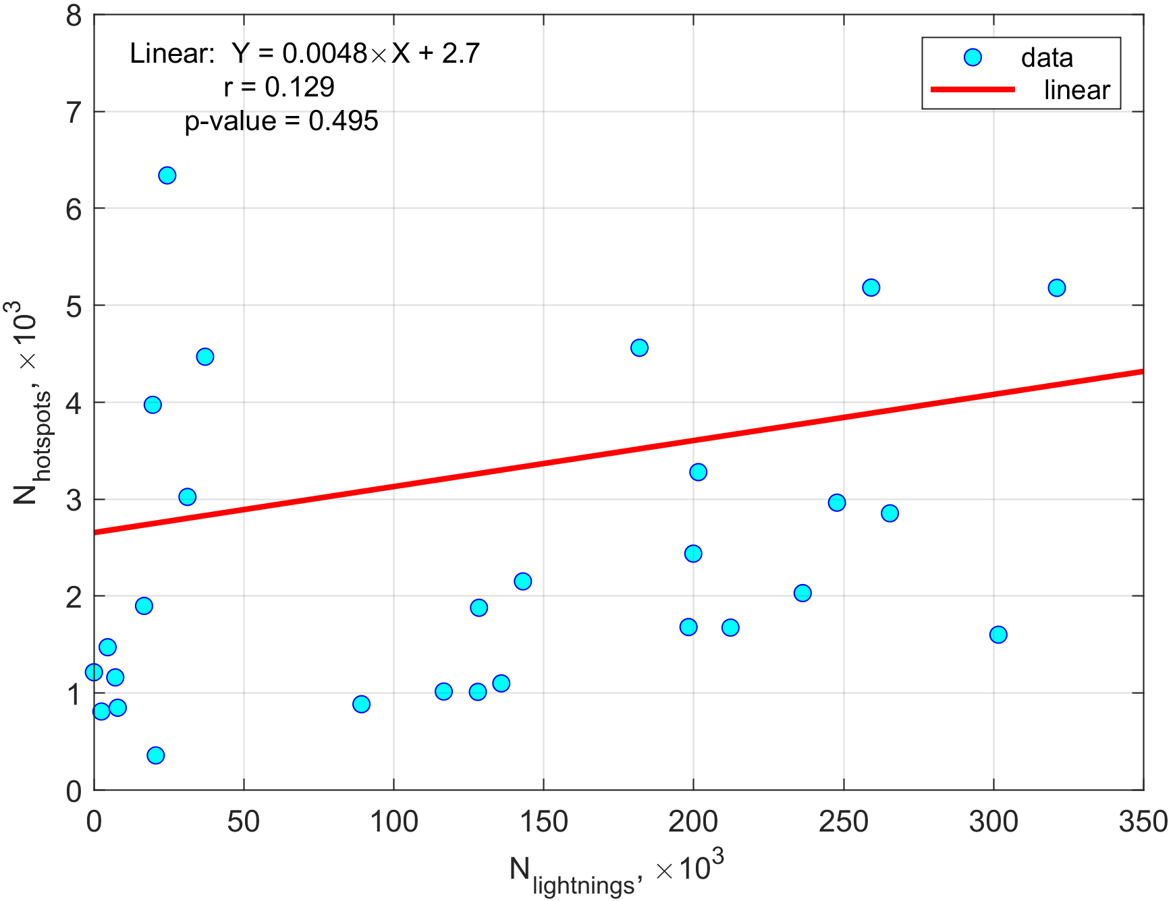
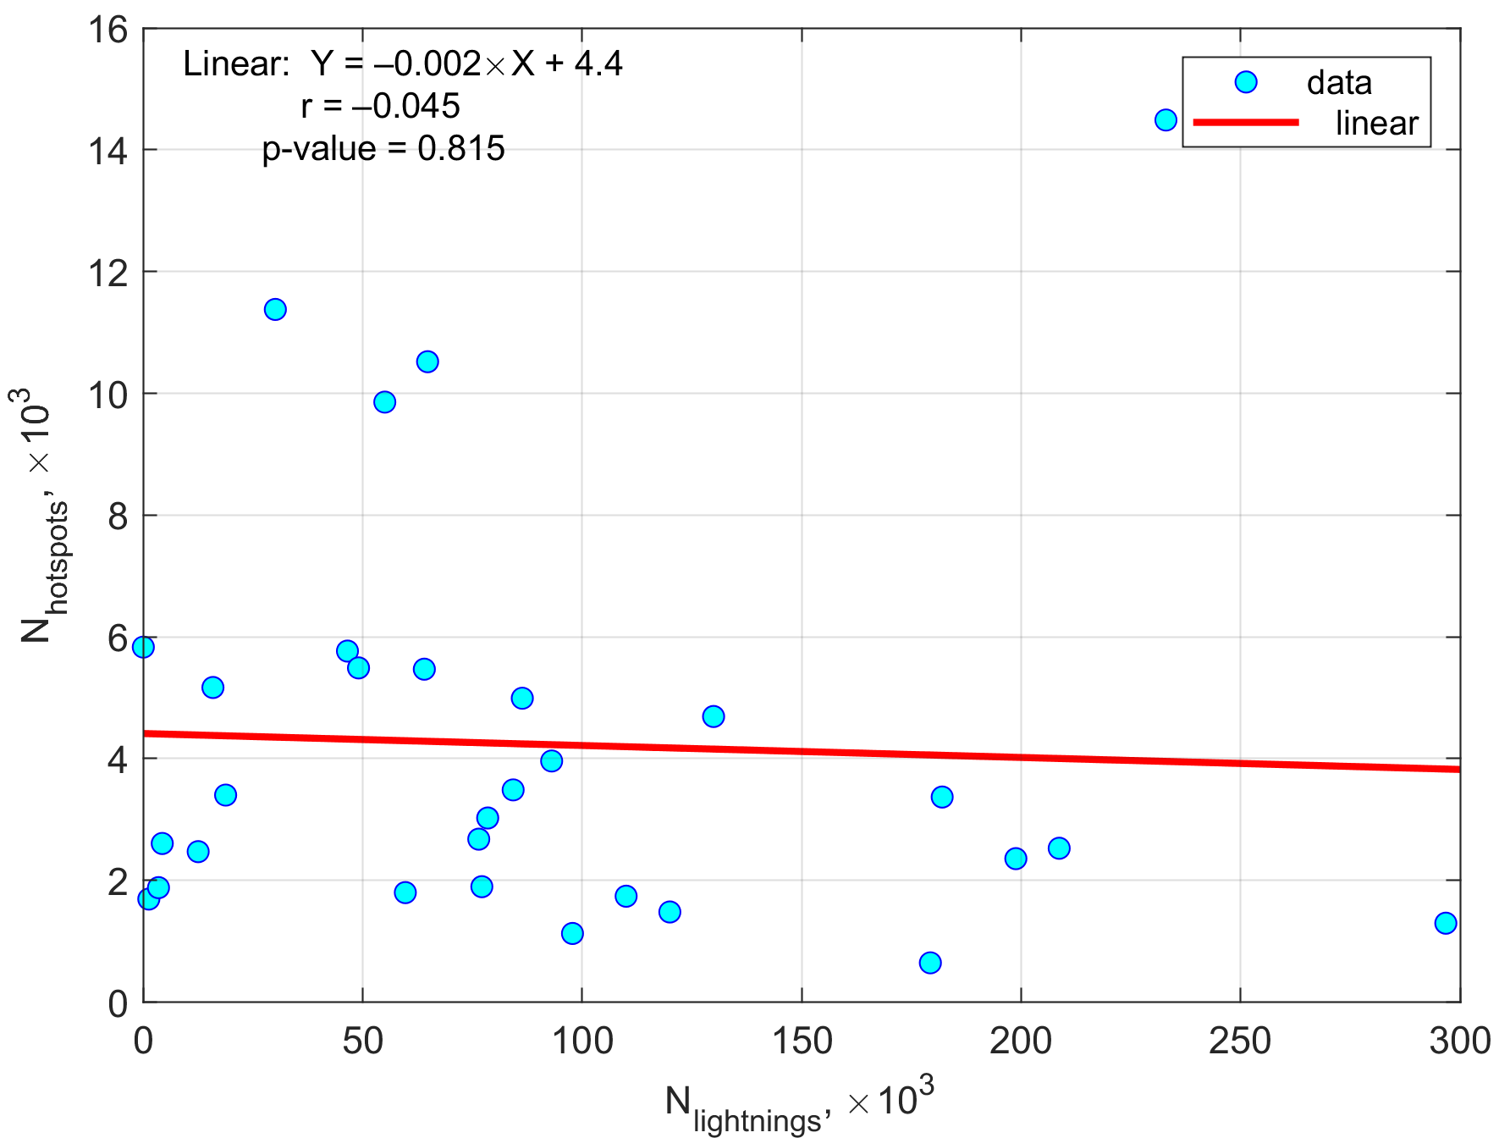
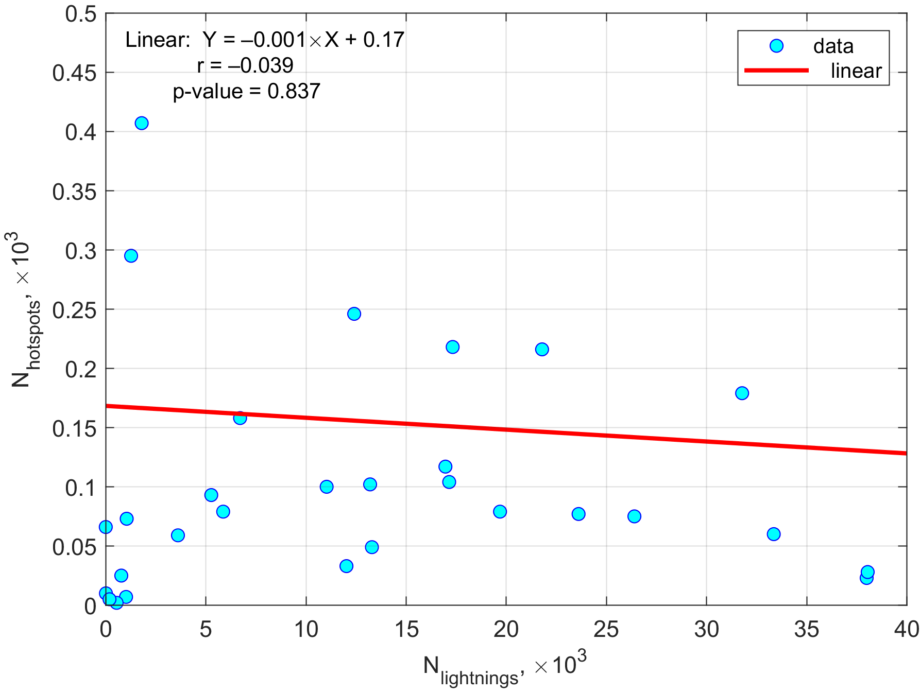
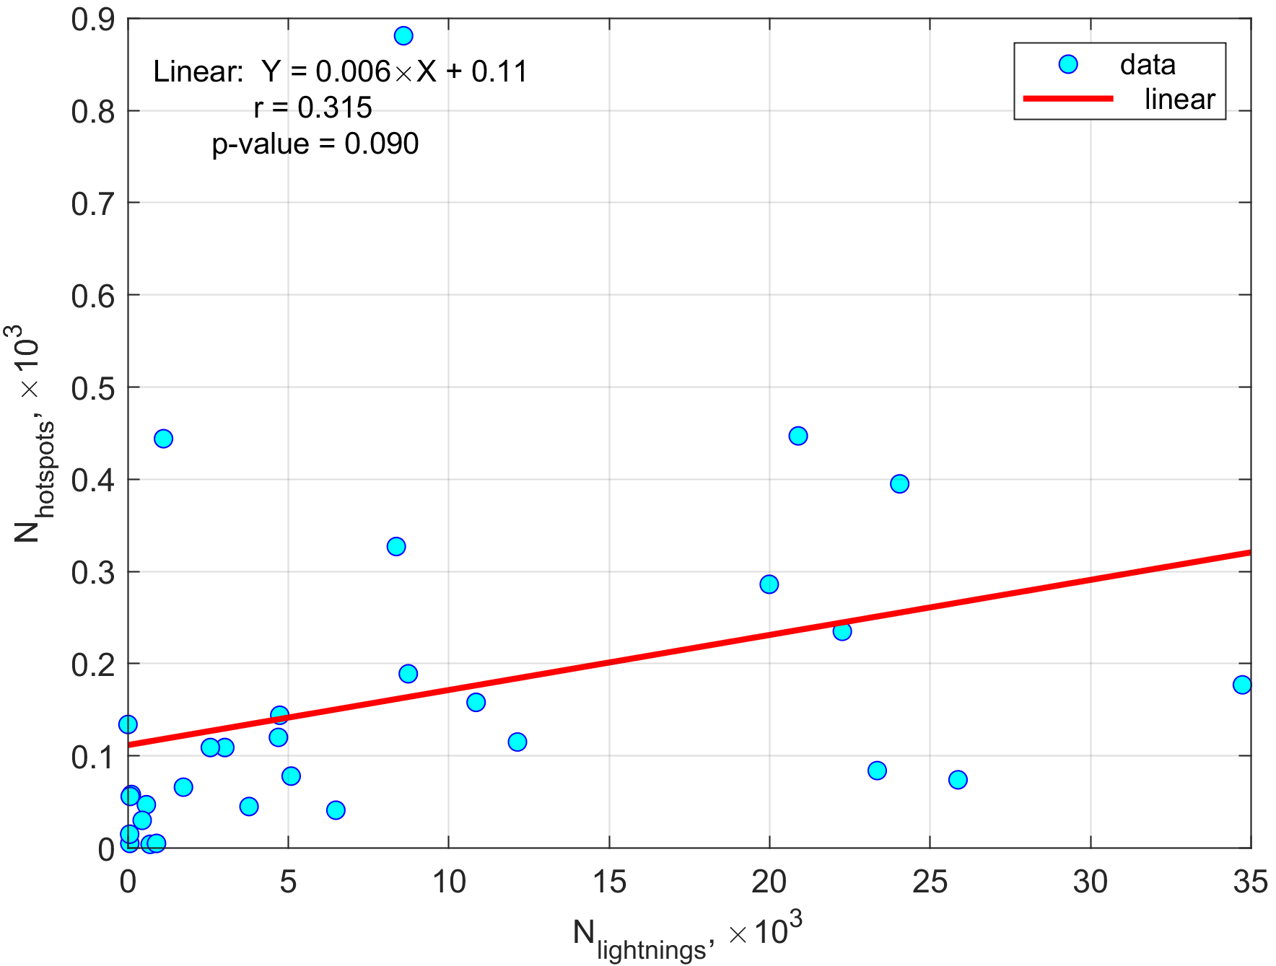
Relationship total number hotspots vs lightning strikes
North (Area 1)
Center (Area 2)
South (Area 3)
The Great Vasyugan
Mire (Area 4)
Permanent
wetlands (Area 5)
May–September
2016-2021

Slide 11
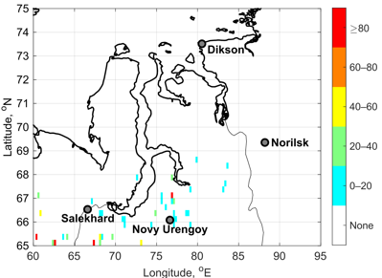
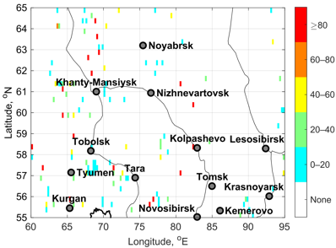
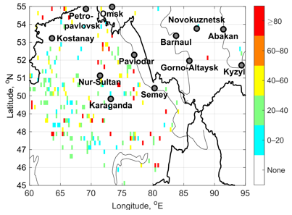
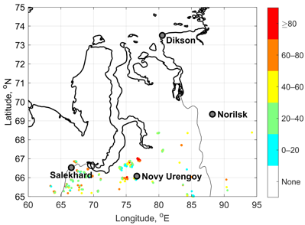
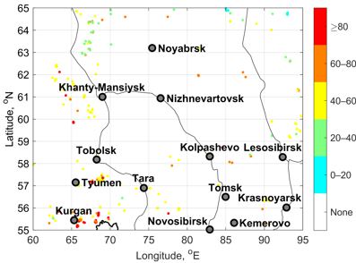
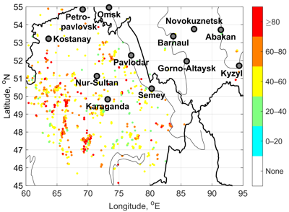
Fires Candidates to be Ignited by Lightning
Probability values (%) based on 2 methods
1. P - cases in each cell with smolder period 1 day
North (Area 1)
Center (Area 2)
South (Area 3)
2. B - cases applying D_max = 10 km and ∆t_max = 10 days
North (Area 1)
Center (Area 2)
South (Area 3)

Slide 12
Relation (in %) total number of hotspots that are likely caused by lightning discharge to total number of hotspots B > 0
Areas | Months
 | May | June | July | August | September | Warm Season
Area 1 (65–75° N, 60–95° E) | 7.1 | 24.4 | 37.1 | 23.7 | 5.1 | 30.2
Area 2 (55–65° N, 60–95° E) | 8.3 | 36.2 | 43.1 | 30.7 | 12.8 | 24.9
Area 3 (45–55° N, 60–95° E) | 9.1 | 33.5 | 31.6 | 16.7 | 10.3 | 19.5
2016–2021

Slide 13
Hotspots & Aerosol Index
July 2021
The MODIS data

Slide 14
Results
The highest lightning activity is observed over the areas with boreal forests, and the highest hotspot density, in contrast, is observed in croplands, savannas, and mixed forests.
The number of fires in the southern part of the territory is about 1.5 times higher than in the northern part, and the fire season is longer, which could be caused by the enhanced influence of anthropogenic factors.
The areas with maximum values of indicated parameters coincided in the southwestern part of the territory, in the mountain regions, and in the northern part of Kazakhstan.
Maximum values of lightning occur in July for the whole territory of Western Siberia, and maximum values of hotspots occur in April in the central and southern regions of Western Siberia.
In most considered areas of the region, the relationship between lightning and hotspots is positive. However, correlation coefficients are low and statistically insignificant.
The probability analysis, based on calculation in the borders of each cell and on proximity index calculation (applying distance parameters and temporal windows), had similar results. However, the second method makes it possible to obtain values that are more accurate.
The probability analysis illustrated that the fire activity caused by lightning discharges in Western Siberia may vary from 5 to 43% during the warm seasons over 2016-2021.
Despite the largest number of fires in the south of the territory, the probability of ignition from lightning over the whole warm season is higher in the northern parts of Western Siberia – up to ~30%.

Slide 15
Conclusion
Thus, the findings in the study allow us to better understand these events’ variability (particularly considering the lack of studies in this direction for the region) and to identify
the areas with the greatest risk of fire danger from lightning. The results of this study will help to improve the assessment of fire regime in different Siberian regions.
However, other climatic parameters, such as atmospheric precipitation, air and soil temperature humidity characteristics, and fire scar data should be considered in the future to identify the phenomenon of dry thunderstorms and their influence on fire occurrence in more detail.
It is important to assess the conditions that lead to the formation of dry thunderstorms in
various natural zones across the Western Siberia, which will help specify climatic models
and improve the fire prevention measures in the regions.
This research is supported by Russian Science Foundation (RSF), project # 22-27-00494, https://www.rscf.ru/en/project/22-27-00494
Thank you for attention!

