Slide 1
Солнечные протонные события как тригер усиления возмущенности верхней ионосферы
M.V. Klimenko^{1,2}, V.V. Klimenko^{1,2}, F.S. Bessarab^{1,2},
T.V. Sukhodolov^{1,2}, E.V. Rozanov^{1,2}
West Department of N.V. Pushkov Institute of Terrestrial Magnetism, Ionosphere and Radio Wave Propagation (IZMIRAN) RAS, Kaliningrad, e-mail: maksim.klimenko@mail.ru
2. St. Petersburg State University, Sankt Petersburg, Russia

Slide 2
Issues of this report
Whole atmosphere EAGLE model as one way for “new life” of GSM TIP model
Ionospheric response to solar proton events and magnetospheric proton precipitation during complex space weather event on January 2005
An ensemble model runs – new paradigm for atmosphere-ionosphere coupling model
Ionospheric variability as a new parameter for investigation of atmosphere-ionosphere coupling processes

Slide 3
GSM TIP Model Brief Description
Thermospheric parameters:
T_{n}, O₂, N₂, O, NO, N(⁴S),N(²D)
densities; vectors of velocities;
(from 80 km to 500 km)
Ionospheric parameters:
O⁺, H⁺, Mol⁺ densities;
T_{i} and T_{e};
Vectors of ion velocities
(from 80 km to 15 Earth radii)
Electric field:
The model was added by the new block of electric field calculation Klimenko et al., 2006, 2007.
Global Self-consistent Model of the Thermosphere, Ionosphere and Protonosphere (GSM TIP) was developed in West Department of IZMIRAN. The model GSM TIP was described in details in Namgaladze et al., 1988.
Notes:
In this model the numerical decision of the hydrodynamics equations for multicomponent gas, consisting of neutral (O₂, N₂, O, H, odd nitogen), and charged (the molecular ions O₂⁺, NO⁺, atomic ions O⁺, H⁺, and electrons) particles is realized.
The model is added by the new block of electric field calculation Klimenko et al., 2006, 2007.

Slide 4
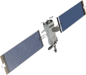
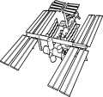
Structure of the Atmosphere
Why do we care?
Credit: John Emmert/Naval Research Lab
Upper atmosphere
SPACE WEATHER
80-90 km
WEATHER, CLIMATE
Middle/lower atmosphere
Everything is coupled!

Slide 5
New whole atmosphere model: EAGLE
EAGLE
HAMMONIA
GSMTIP
ERA-Interim
nudging
Stratospheric
aerosols
Solar
irradiance
GHG/
ODS
Lower
Boundary conditions
D, E, F1 Ionosphere
80-175 km
Mostly molecular ions, electrons
Ion-involved reactions
Ion, electron/neutral interactions
Thermosphere
80-520 km, L30
5˚-5˚
Neutral chemistry
Neutral dynamics
Physics & Dynamics
0-180(280) km, L119
1.9˚-1.9˚, T63
Column physics
Tracer transport
Chemistry
48 species
107 neutral reactions
46 photolysis reactions
18 ion-involved reactions
Solar EUV
Auroral precipitation/
Field-aligned current
Electric
field
F2 Ionosphere, Protonosphere
175-100000 km
Mostly atomic ions, electrons
Quasihydrodynamics
Sea ice
Sea temperature
Land use
Ionization rates (MA)
Ionization rates (UA)
Whole Atmosphere Global Model
Klimenko et al.., 2017, 2018,2019; Vasiljev et al., 2019
Notes:
To solve this problem we decided to use absolutely new for us approach: produce coupling of GSM TIP and HAMMONIA model. How we can performed such coupling? Due to presence of the overlapping area of these models (80-250 km) we can do such coupling by different way. In any case we developed different version of absolutely new whole atmosphere global model EAGLE.

Slide 6
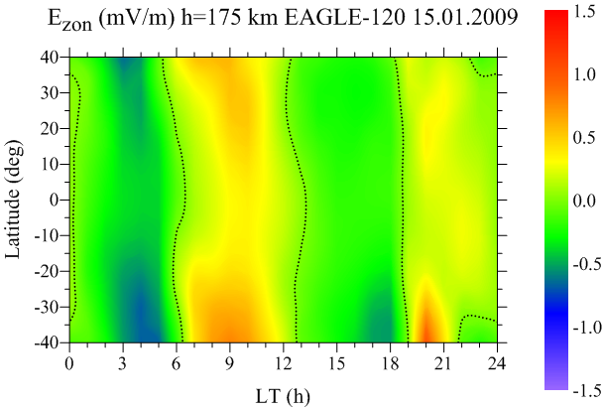
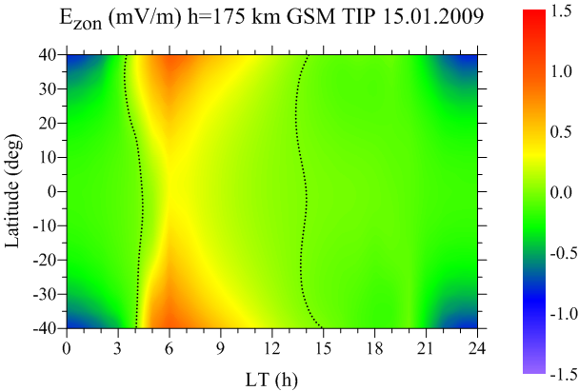
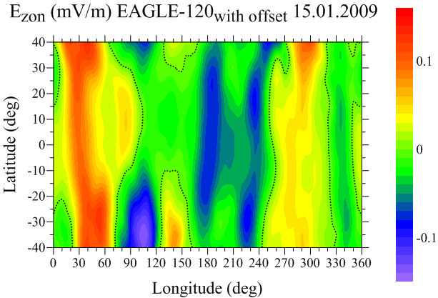
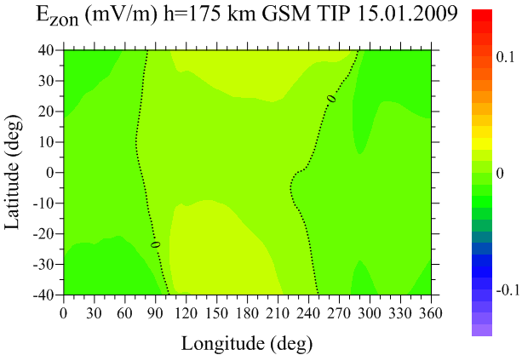
PRE and four-peak structure in zonal EF
EAGLE
Klimenko et al., 2019
GSM TIP
PRE
NO PRE

Slide 7
Solar proton events
Reames, 1999
Solar coronal mass ejection → acceleration of plasma → Solar Proton Event (SPE)
Integral flux of protons with energies above 10 MeV exceeds 1 pfu = 1 cm2 s1 sr1
Patterson et al., 2001
Solar protons precipitate into the Earth’s magnetosphere mostly in the polar cap region
Protons can have very high energies (up to several GeV)
Release of a large amount of energy in the mesosphere and stratosphere
In total, from 1976 to 2017, 267 SPEs with substantially different proton fluxes and energies were registered
On average about 80 per one 11-year solar activity cycle (see, for example, http://umbra.nascom.nasa.gov/SEP/).

Slide 8
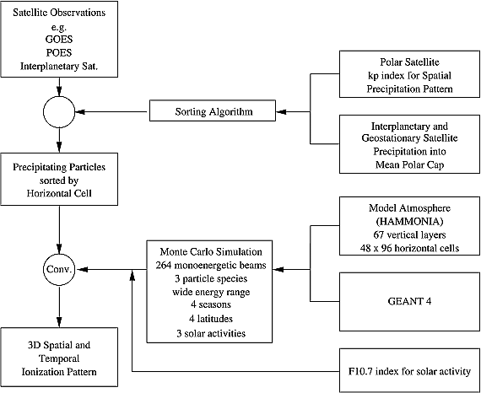
Atmospheric Ionization Module Osnabrück (AIMOS): A 3‐D model to determine atmospheric ionization by energetic charged particles from different populations
Journal of Geophysical Research: Space Physics, Volume: 114, Issue: A6, First published: 16 June 2009, DOI: (10.1029/2008JA013884)
Notes:
AIMOS flow chart.
IF THIS IMAGE HAS BEEN PROVIDED BY OR IS OWNED BY A THIRD PARTY, AS INDICATED IN THE CAPTION LINE, THEN FURTHER PERMISSION MAY BE NEEDED BEFORE ANY FURTHER USE. PLEASE CONTACT WILEY'S PERMISSIONS DEPARTMENT ON PERMISSIONS@WILEY.COM OR USE THE RIGHTSLINK SERVICE BY CLICKING ON THE 'REQUEST PERMISSIONS' LINK ACCOMPANYING THIS ARTICLE. WILEY OR AUTHOR OWNED IMAGES MAY BE USED FOR NON-COMMERCIAL PURPOSES, SUBJECT TO PROPER CITATION OF THE ARTICLE, AUTHOR, AND PUBLISHER.

Slide 9
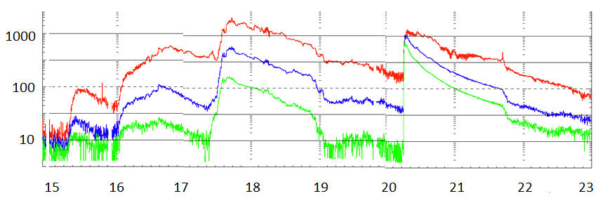
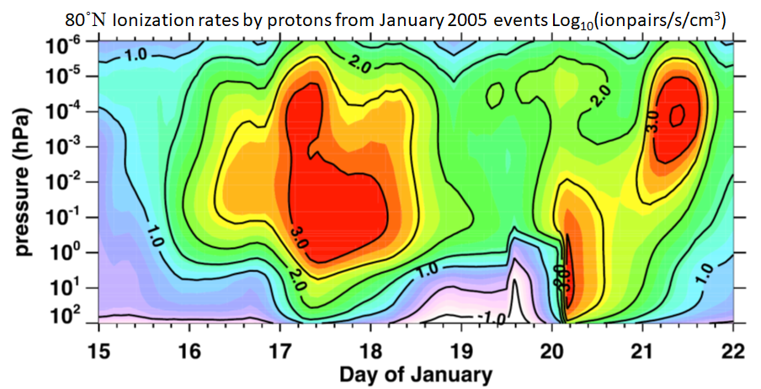
Solar proton events and proton precipitation
Proton Flux Measurements by GOES 11 (Particles cm⁻² s⁻¹ sr⁻¹) (Edgar A. Bering et al, 2015)
>10 MeV
>50 MeV
>100 MeV
AIMOS log-ionization rates by protons (ionpairs cm⁻² s⁻¹)

Slide 10
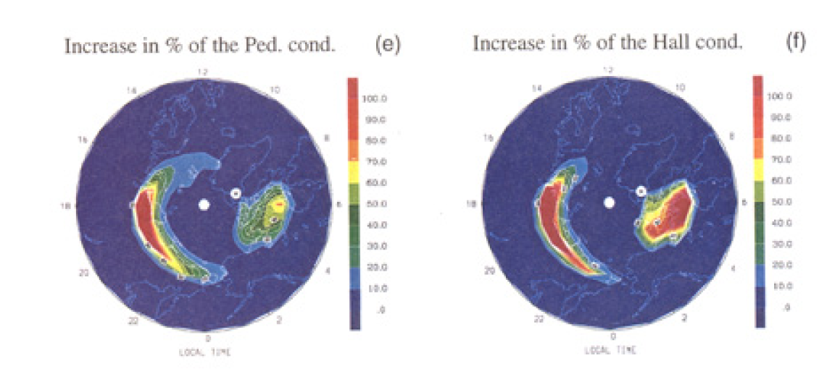
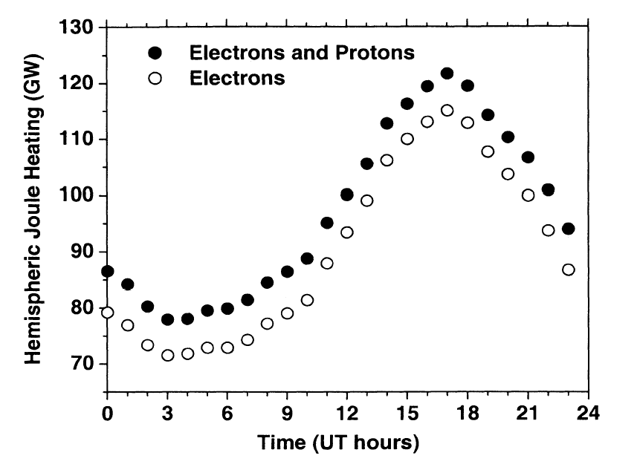
Ionosphere during SPE and proton precipitation
Dmitriev et al., 2006
Galand et al., 2000

Slide 11
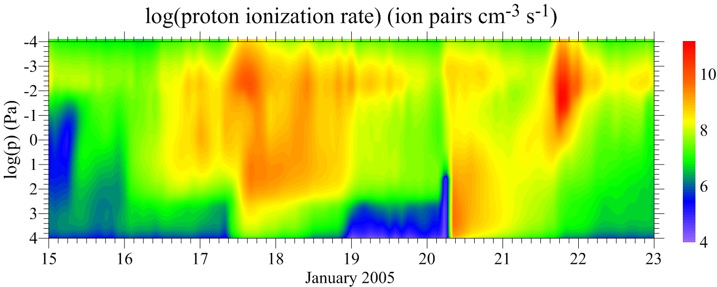
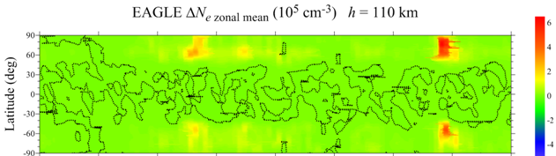
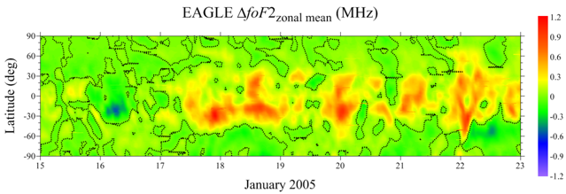
Отклик на SPE и магнитосферные протоны

Slide 12
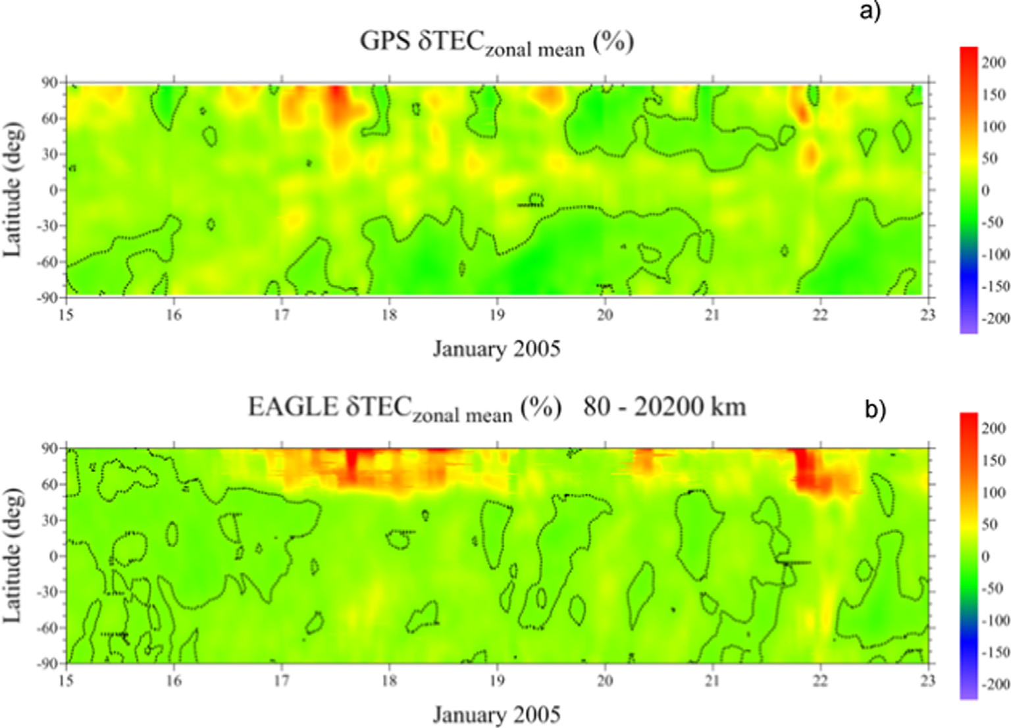
Отклик ПЭС на солнечное протонное событие
Bessarab et al., 2021 ASR

Slide 13
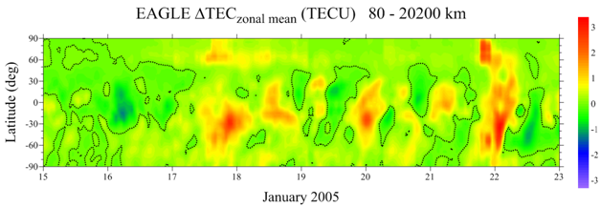
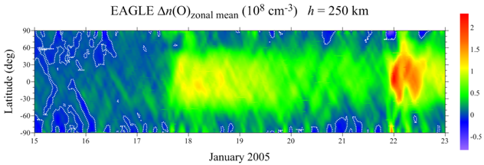
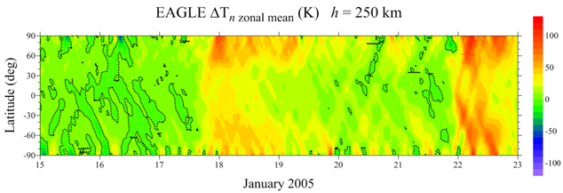
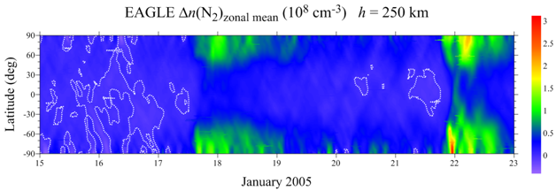
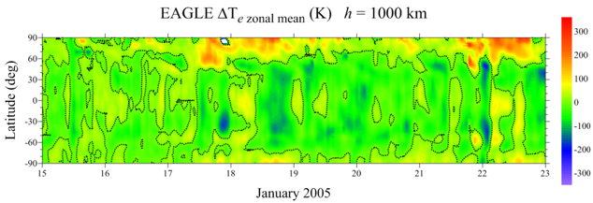

Slide 14
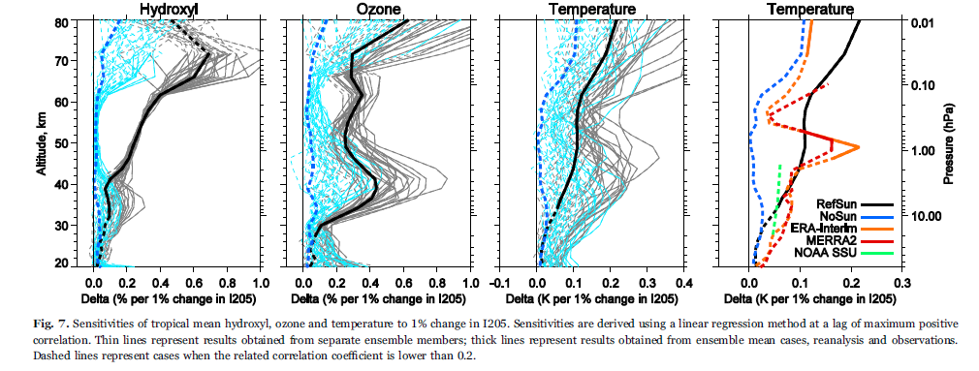
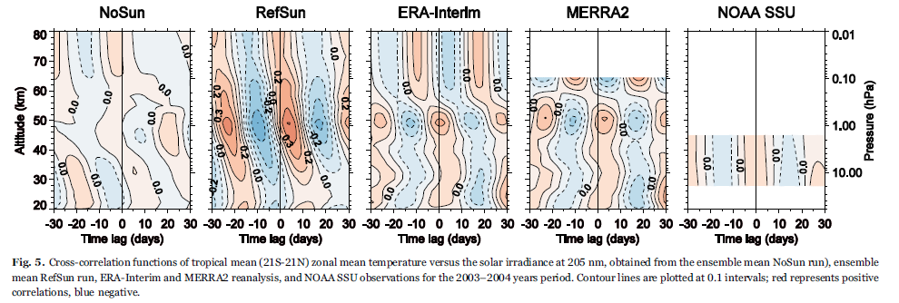
Использование ансамблевых расчетов
Sukhodolov et al., 2016

Slide 15
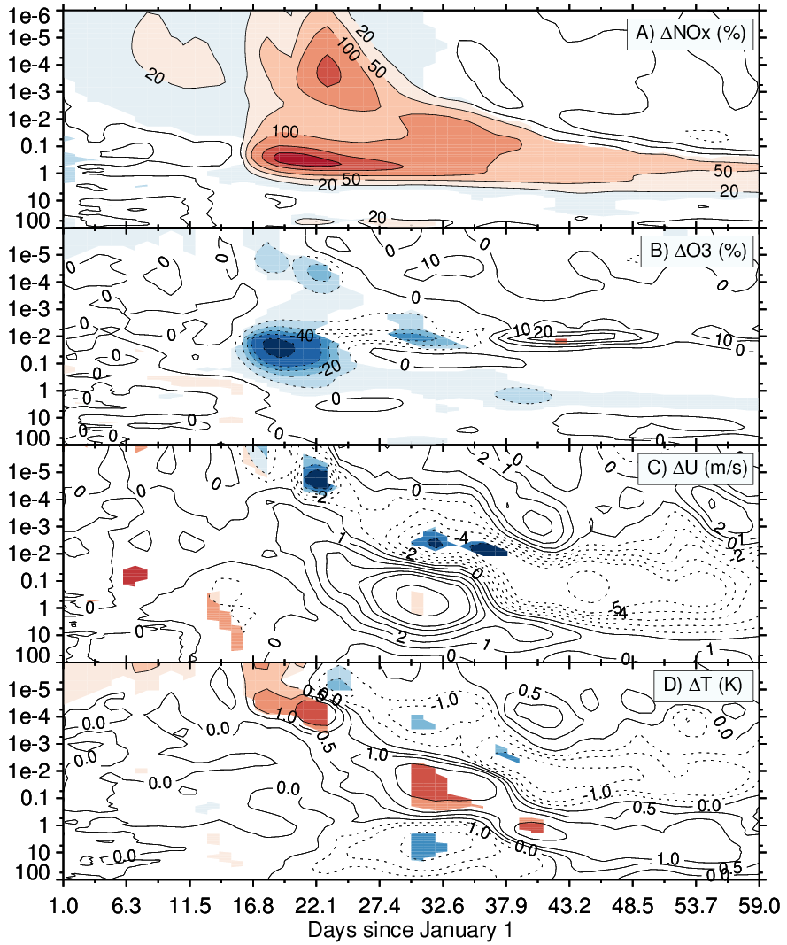
Ансамблевые расчеты HAMONIA январь 2005

Slide 16
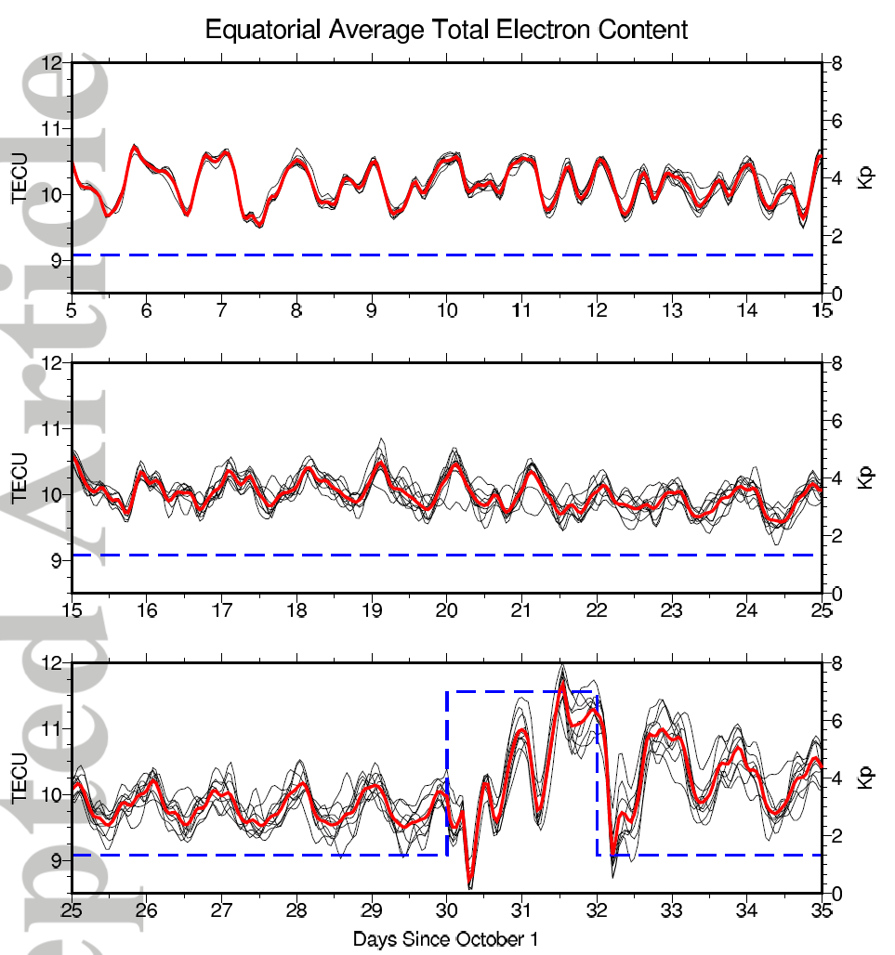
Pedatella, H.-L Liu, 2018

Slide 17
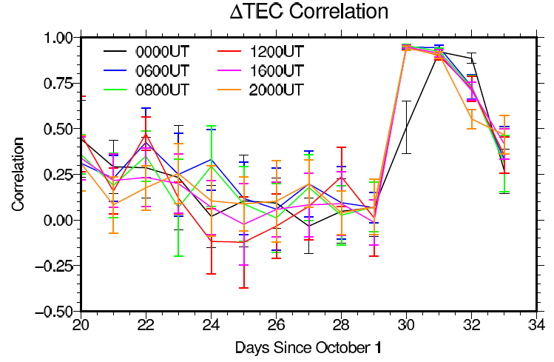

Slide 18
In ensemble calculations, the initial conditions of the temperature fields at altitudes of 0-90 km randomly changed by 1 K. These temperature changes at different heights and different points in space were not systematic but rather represent a spatial white noise. Calculations were carried out from January 1 to January 31 for quiet and disturbed conditions. In the quiet conditions runs, the precipitation of protons was prescribed on the January 1 level, while in the perturbed conditions runs the proton precipitation changed every 2 hours according to the AIMOS model.

Slide 19
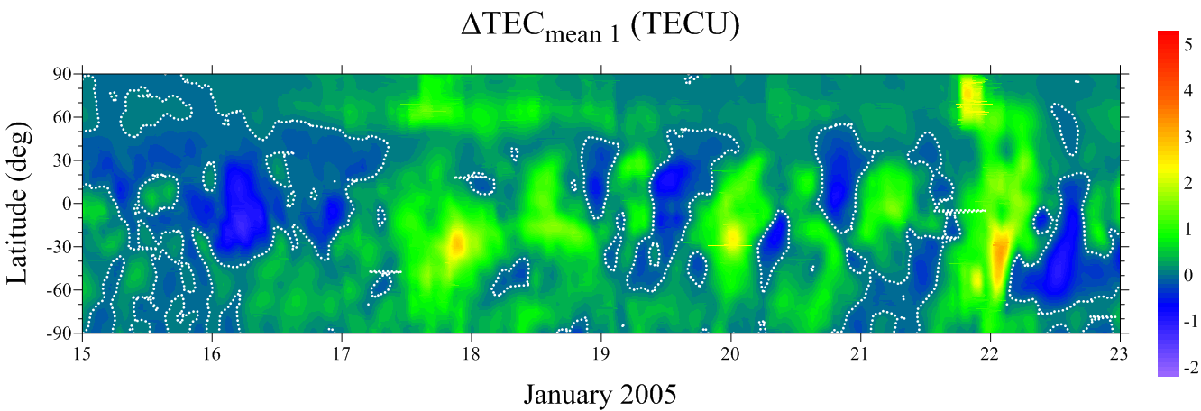
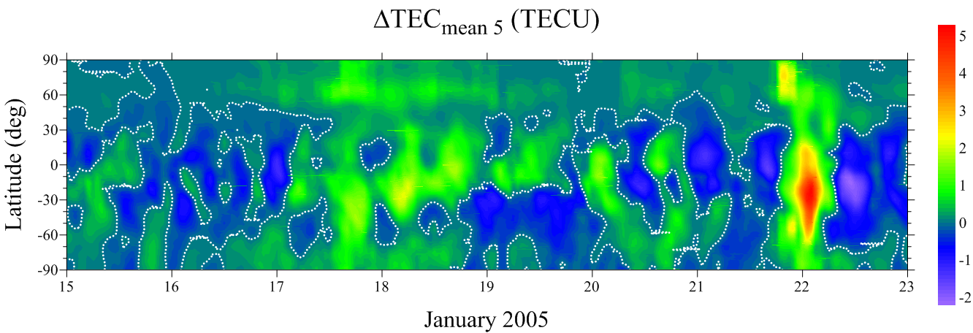
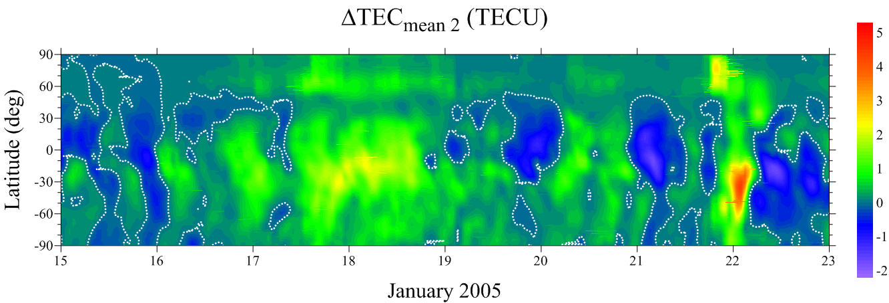
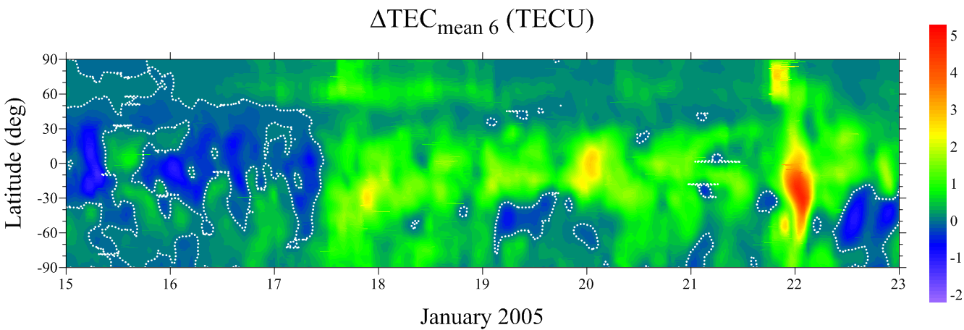
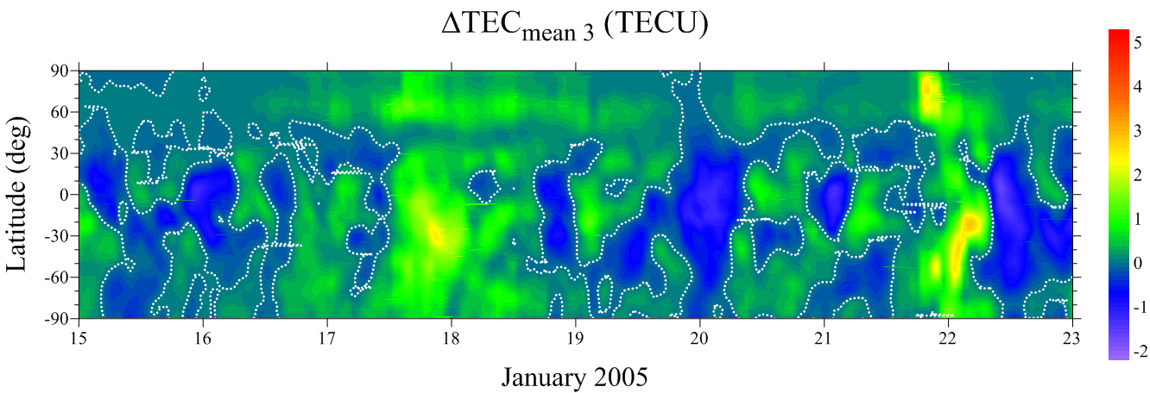
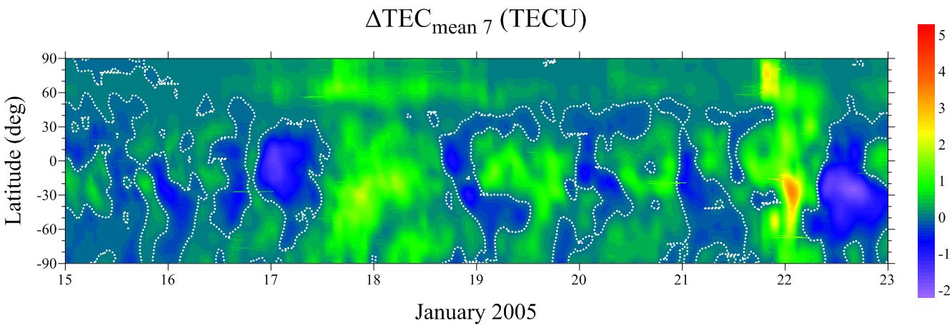
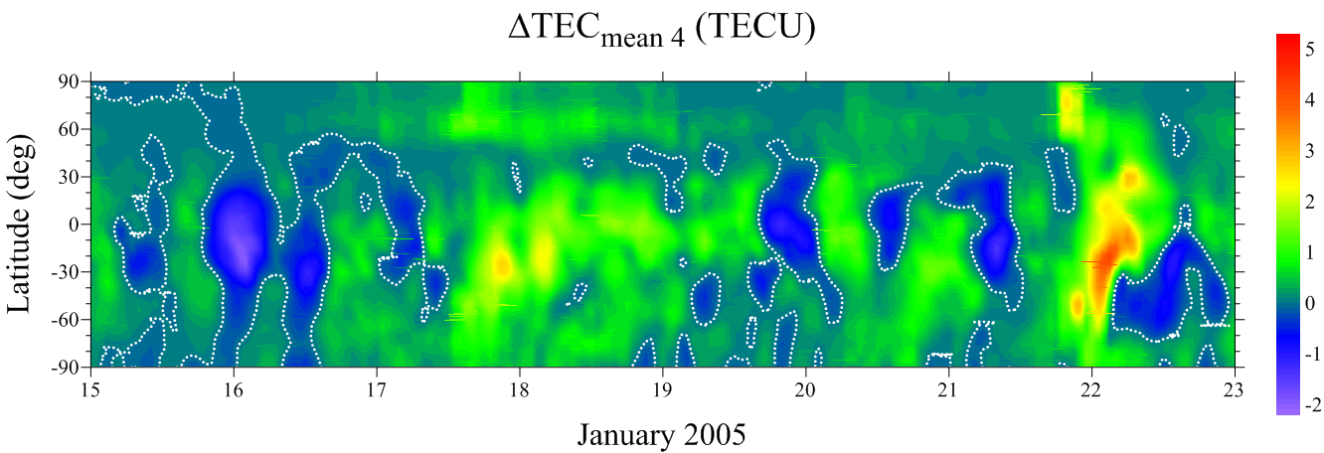
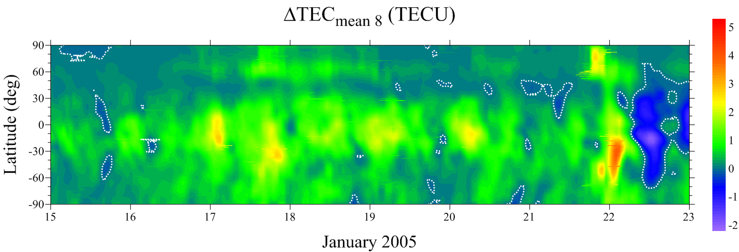
Возмущения ПЭС в 8 ансамблевых расчетах

Slide 20
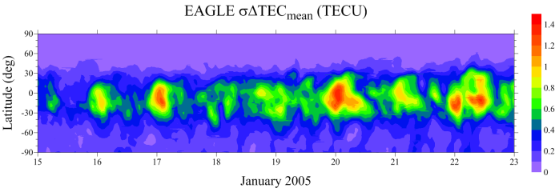
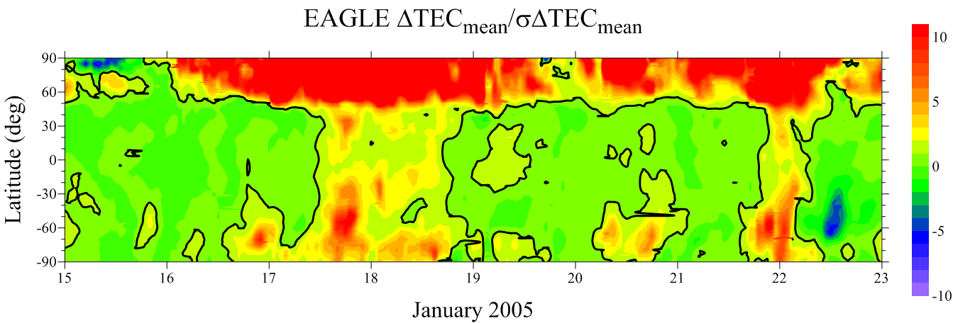
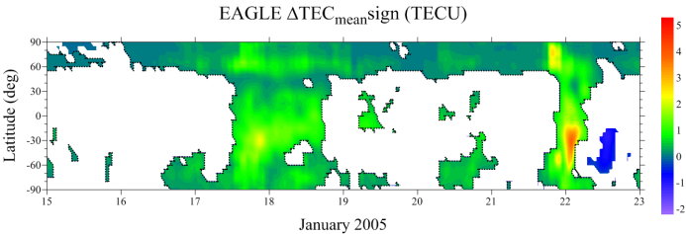
Ансамблевые модельные расчеты – новая парадигма в моделировании ионосферы
шум за счет вариаций в атмосфере
Отношение сигнал/шум
Значимые возмущение

Slide 21
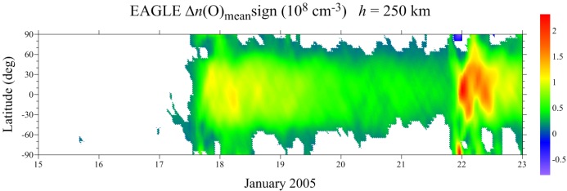
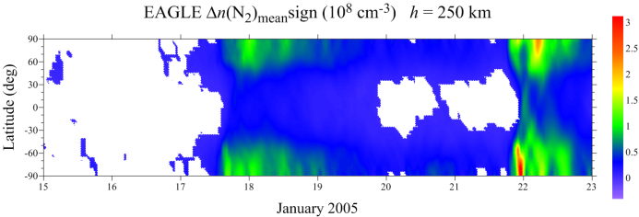
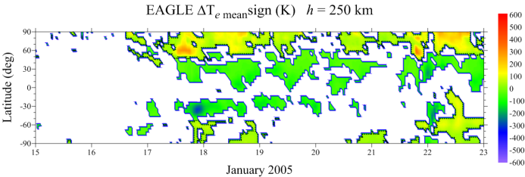
Значимые возмущение

Slide 22
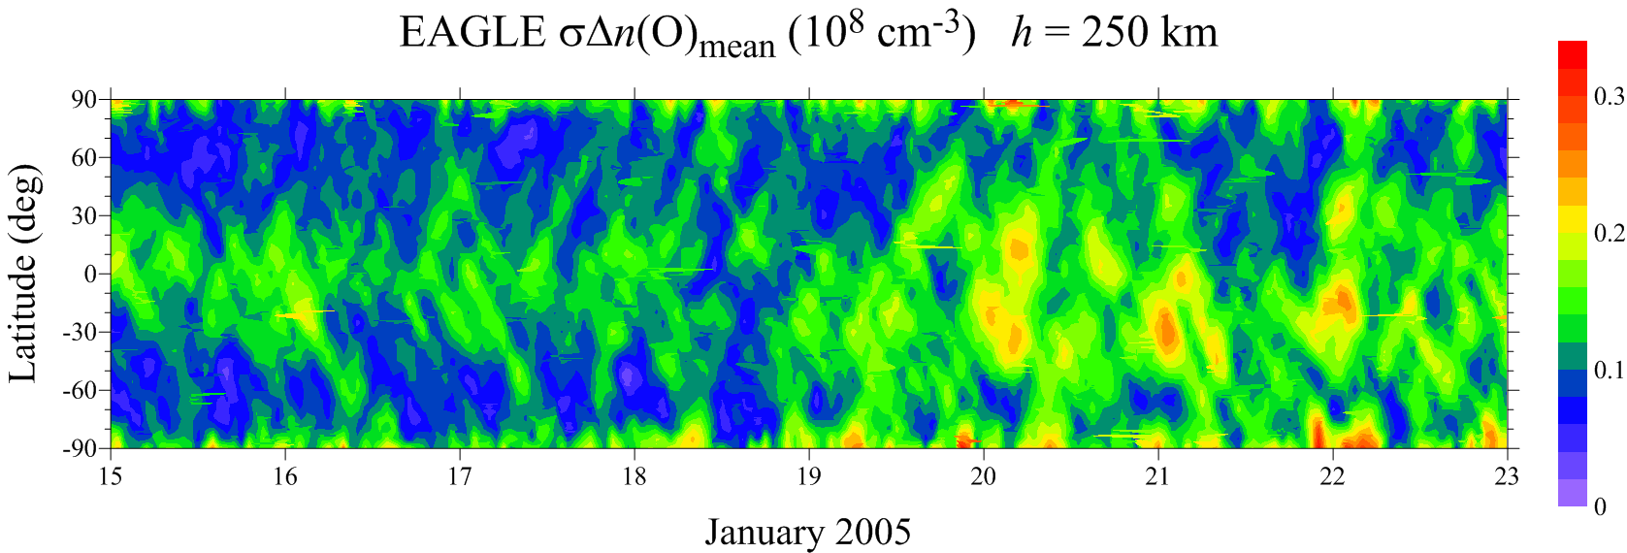
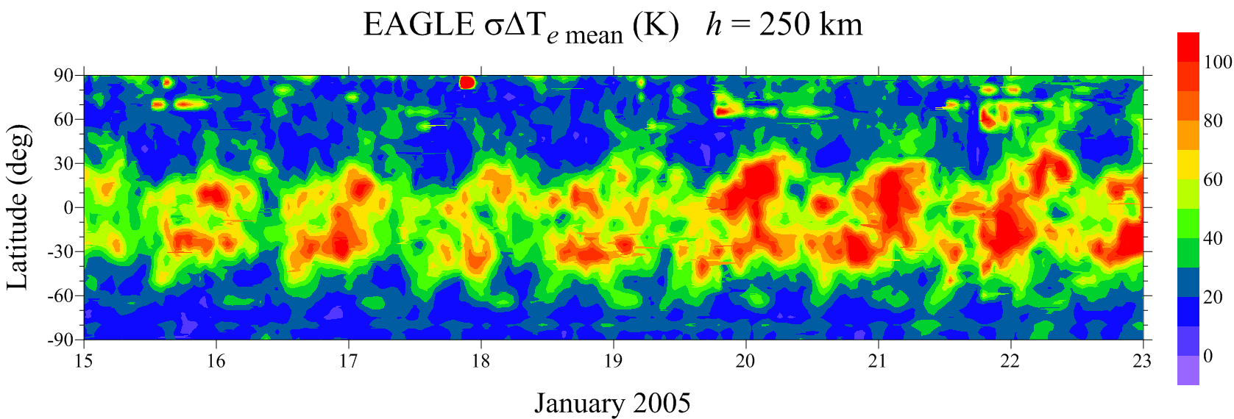
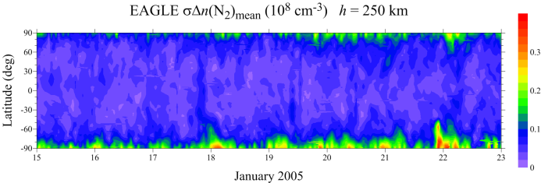
Среднеквадратичное отклонение
Шум за счет вариаций в атмосфере - Internal atmospheric variability

Slide 24
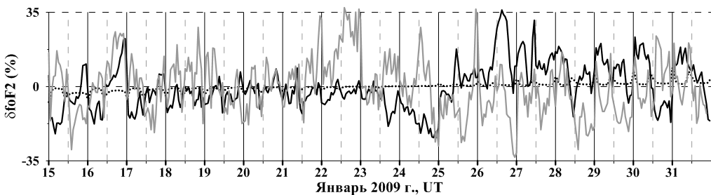
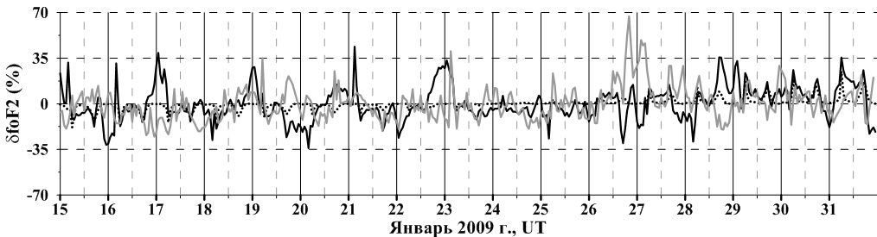
Атмосферно-ионосферные связи в формировании изменчивости ионосферы
Irkutsk
Kaliningrad
dfoF2 (%)
 | Kaliningrad | Irkutsk
EAGLE | 13 | 11
GSMTIP | 4 | 2
Observations | 13 | 13

Slide 25
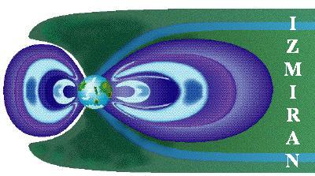
Заключение
В рамках гранта РНФ создана первая Российская модель всей атмосферы - EAGLE, охватывающая высоты от поверхности Земли до 100 000 км и не имеющая аналогов в Европе
Подтверждена важная роль атмосферно-ионосферного взаимодействия при описании ионосферных возмущений во время сложного явления космической погоды
Представлена оценка роли высыпаний протонов на динамические процессы и вариативность параметров верхней атмосферы
Планы
Расчет этого события с учетом эффектов геомагнитных возмущений на моделях ГСМ ТИП и EAGLE.
Работа выполнена при финансовой поддержке гранта РНФ № 21-17-00208.

Slide 26
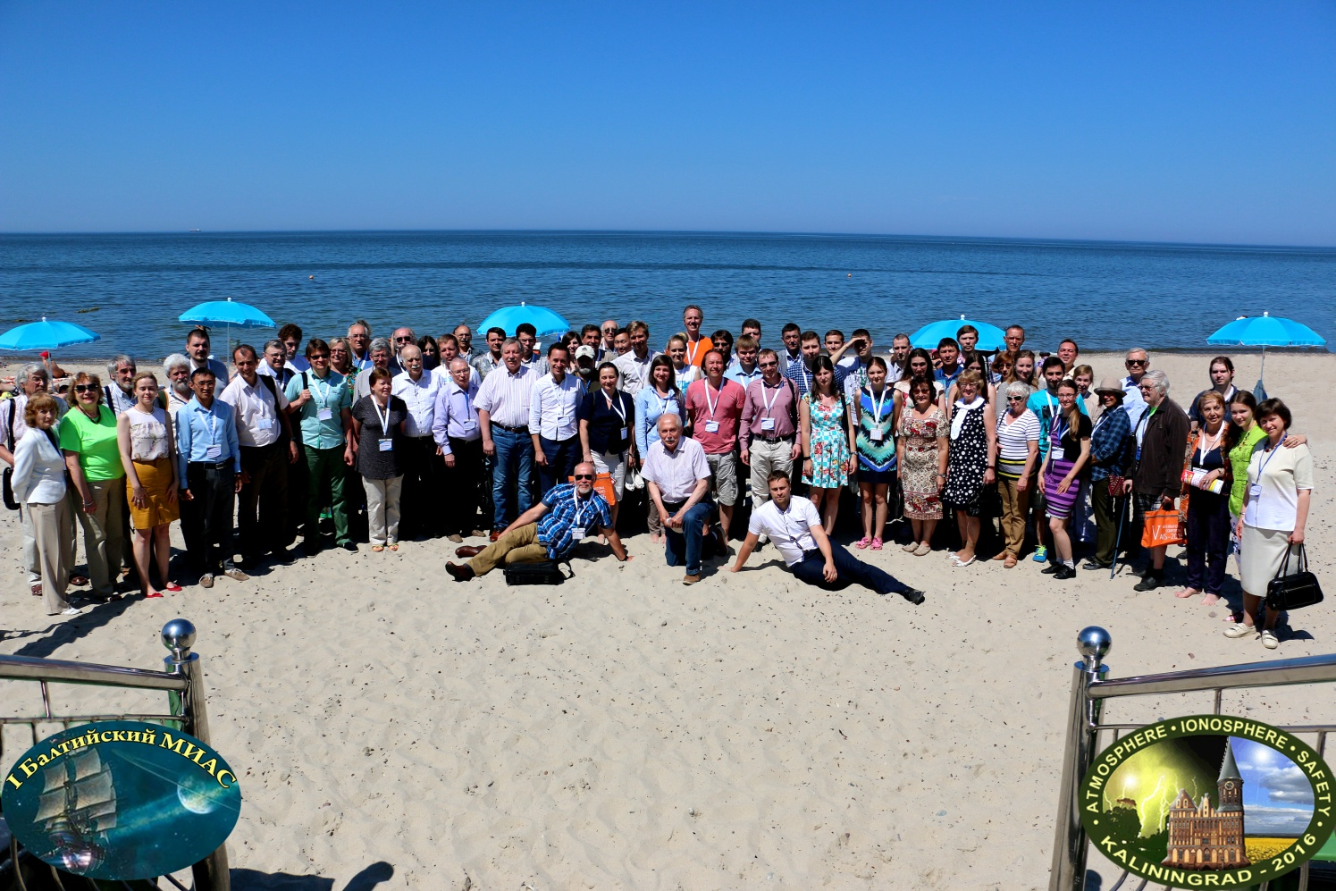
THANKS FOR YOUR ATTENTION!
Welcome to Kaliningrad in 2023 (AIS and MIAC)
AIS – Atmosphere, Ionosphere, Safety conference
MIAC – Magnetosphere-Ionosphere-Atmosphere Coupling School for Young Scientists

Slide 27
Storm and After-storm ionospheric disturbances
Klimenko et al., 2015, 2017 Geomagnetism and Aeronomy, ANGEO
Klimenko et al., 2018 JASTP
GPS ΔTEC
model ΔTEC
model ΔfoF2
irtamΔfoF2

Slide 28
Klimenko et al., 2018 JASTP
ΔEzon
ΔV_{nΘ}
ΔTn
Δn(O)
Δn(N₂)

Slide 29
А) STORM’S MAIN PHASE
t > t0
t > t0 + 1÷3 h.
t > t0 + 3÷12 h.
t0 – time of storm onset
N2
Bulge
Qeq∼const,O↑⇒ρ↑
Tn↓⇒N2↓
O transport
N2↑ O↓
N2↑ O↑
O↑
N2↓
Ne
Ne
Ne
Ne
Ne↑
Qpol
Ne↑
WINDS
plasma
plasma
POLE
MID-LATITUDE
EQUATOR
designed by Kotova

Slide 30
B) AFTERSTORM EFFECT
O transport
O↑⇒Tn↓⇒ N2↓
O/N2↑⇒
Ne
RECOVERY
STORM
PHASE
WINDS
plasma
Qeq
Ne↓
QUIET
Qpol
POLE
MID-LATITUDE
EQUATOR
Notes:
30

Slide 31
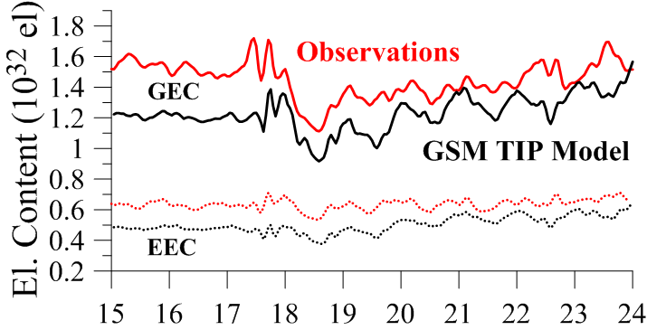
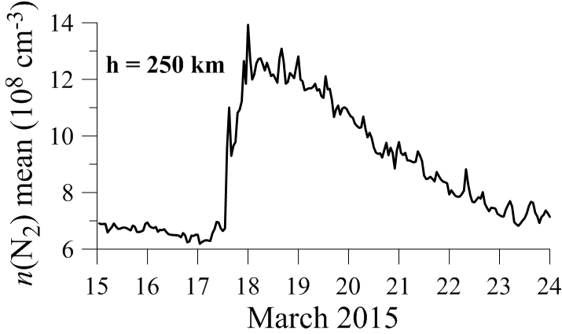
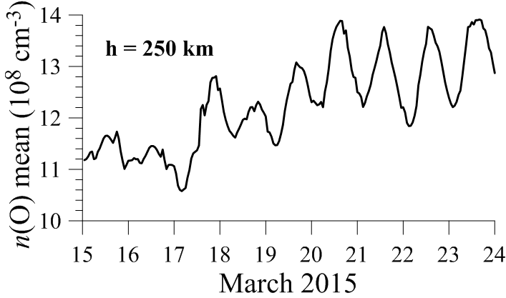
Новая особенность эффектов последействия?

